Slide 1
Graphical User Interfaces with Windows Forms: Part 2
Chapter 15 of Visual C# How to Program, 6/e

Slide 2
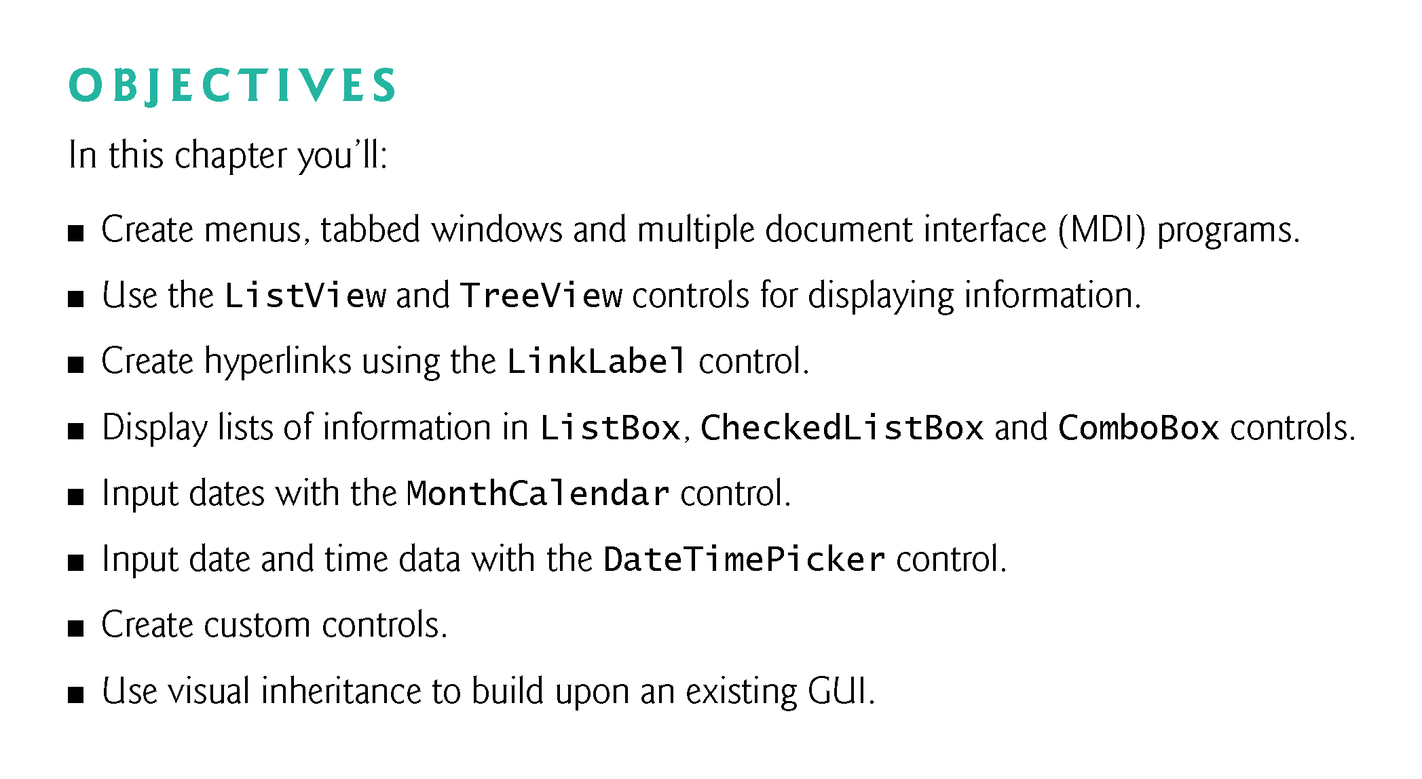

Slide 3
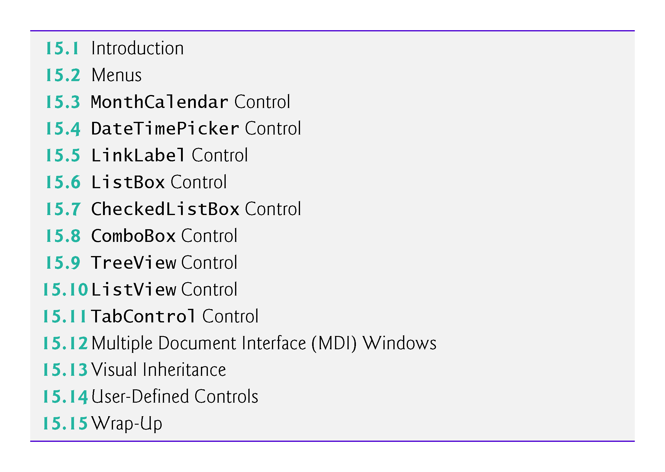

Slide 4
15.1 Introduction
Visual Studio provides a large set of GUI components.
Visual Studio also enables you to design custom controls and add them to the ToolBox.

Slide 5
15.2 Menus
Menus provide groups of related commands for Windows Forms apps (Fig. 15.1).
Menus organize commands without “cluttering” the GUI.
Notes:
Cluttering
杂乱无章
Záluànwúzhāng

Slide 6
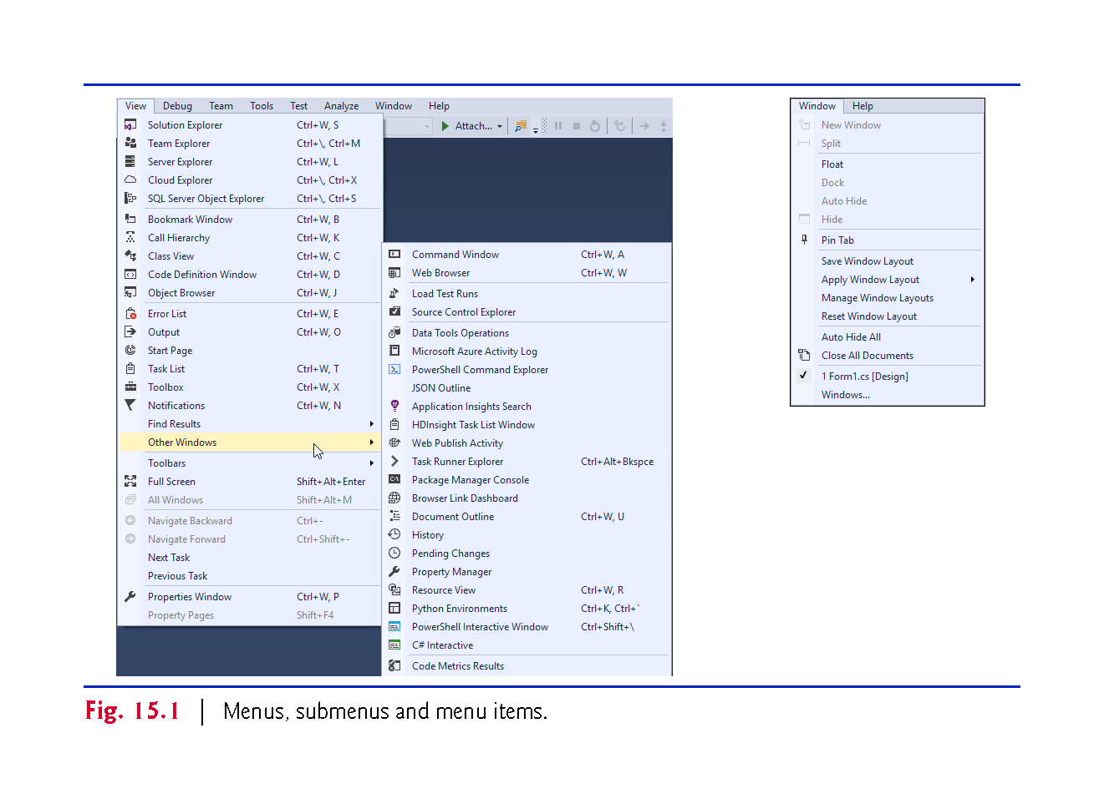

Slide 7
15.2 Menus (Cont.)
To create a menu, open the Toolbox and drag a MenuStrip control onto the Form.
To add menu items to the menu, click the Type Here TextBox (Fig. 15.2) and type the menu item’s name.

Slide 8
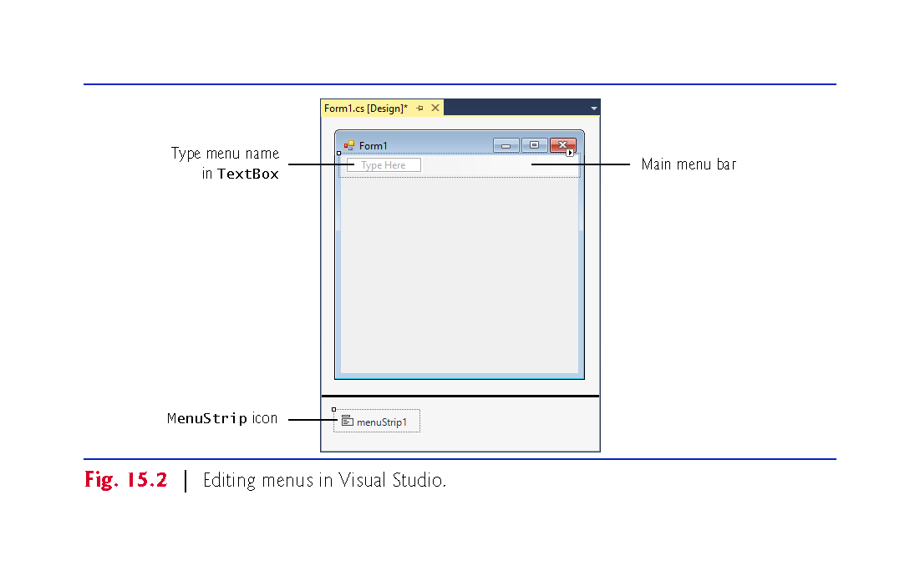
Menu bar

Slide 9
15.2 Menus (Cont.)
After you press the Enter key, the menu item is added.
More Type Here TextBoxes allow you to add more items (Fig. 15.3).

Slide 10
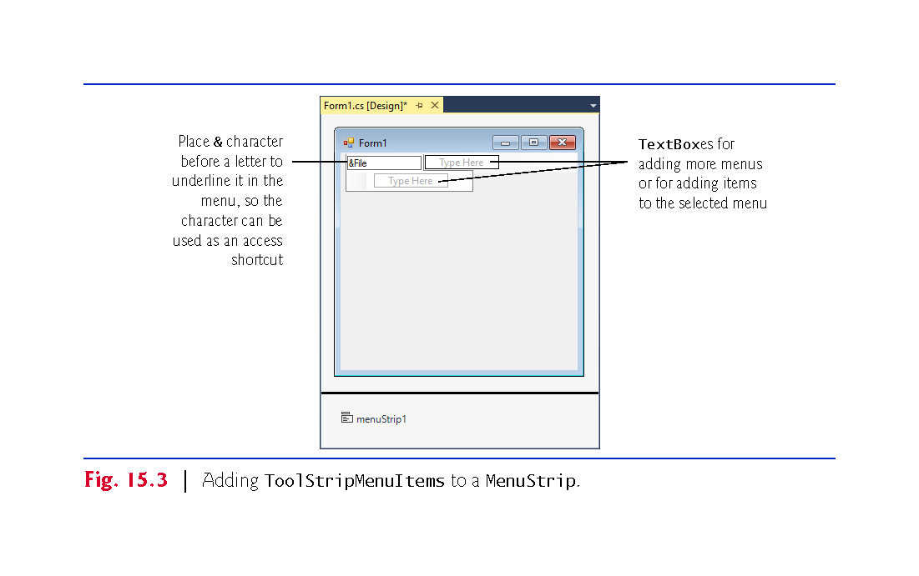

Slide 11
15.2 Menus (Cont.)
Menus can have Alt key shortcuts which are accessed by pressing Alt and the underlined letter.
To make the File menu item have a key shortcut, type &File.
The letter F is underlined to indicate that it’s a shortcut.

Slide 12
15.2 Menus (Cont.)
Menu items can have shortcut keys as well (Ctrl, Shift, Alt, F1, F2, letter keys, and so on).
To add other shortcut keys, set the ShortcutKeys property (Fig. 15.4).

Slide 13
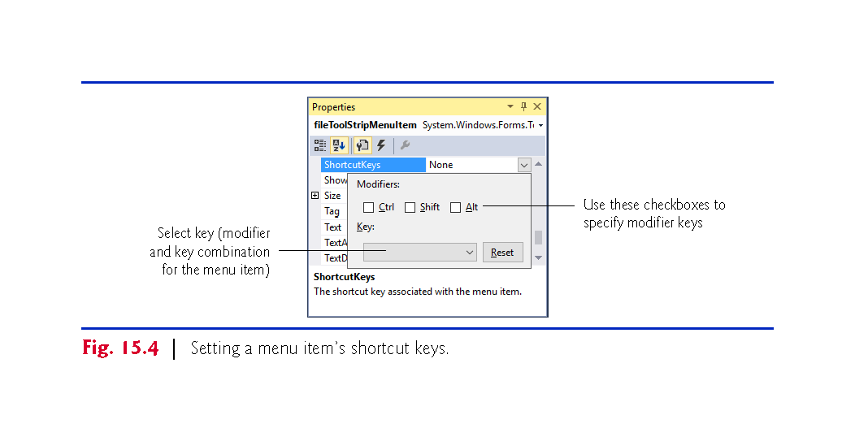

Slide 14
15.2 Menus (Cont.)
You can remove a menu item by selecting it with the mouse and pressing the Delete key.
Menu items can be grouped?? by separator bars, which are inserted by right clicking and selecting Insert > Separator or by typing “-” for the text of a menu item.

Slide 15
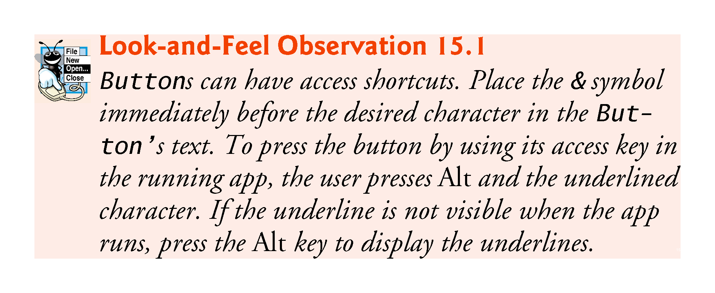

Slide 16
15.2 Menus (Cont.)
Visual Studio allows you to add TextBoxes and ComboBoxes as menu items.
Before you enter text for a menu item, you are provided with a drop-down list.
Clicking the down arrow allows you to select the type of item to add (Fig. 15.5).

Slide 17
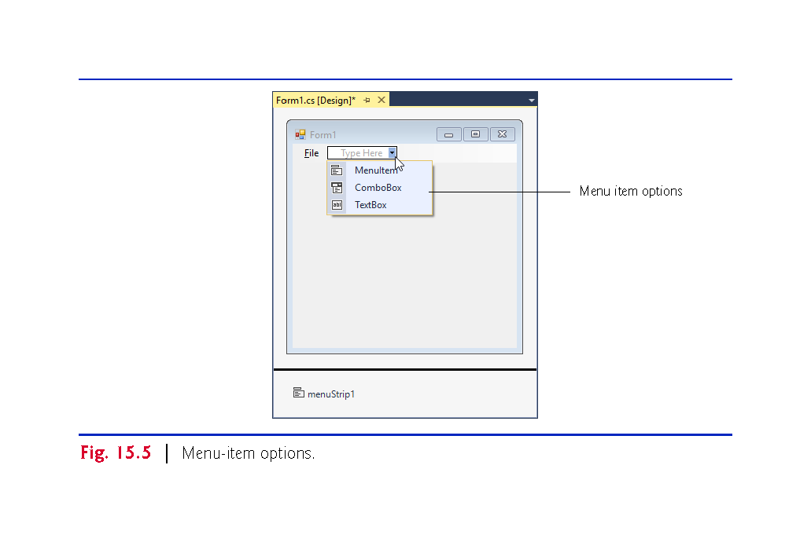

Slide 18
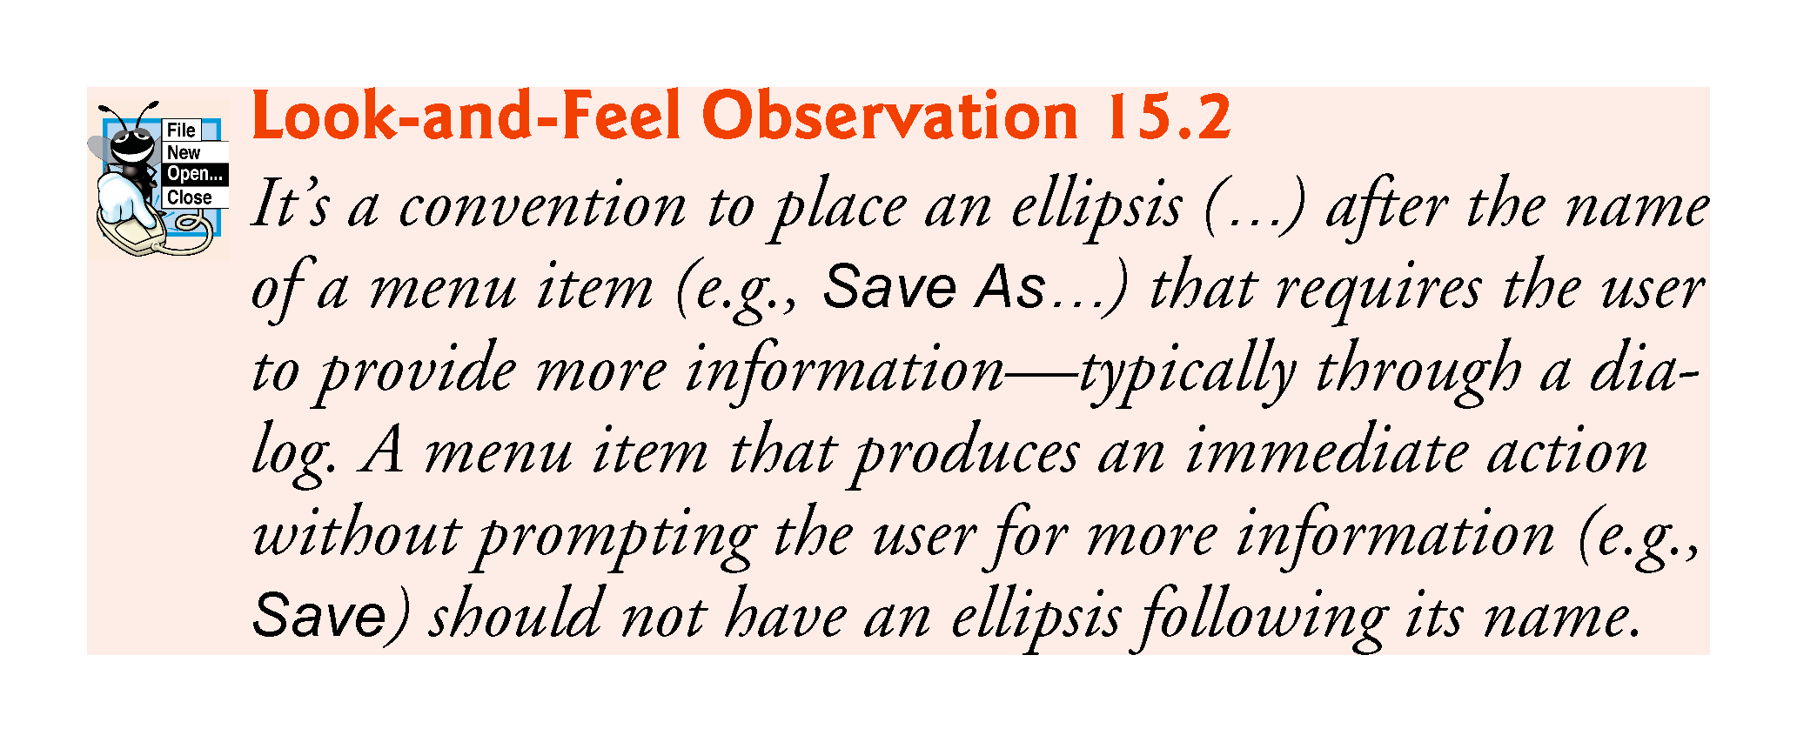
Notes:
Ellipsis
əˈlipsis
Shengluehao
Ellipse
əˈlips
tuoyuan

Slide 19
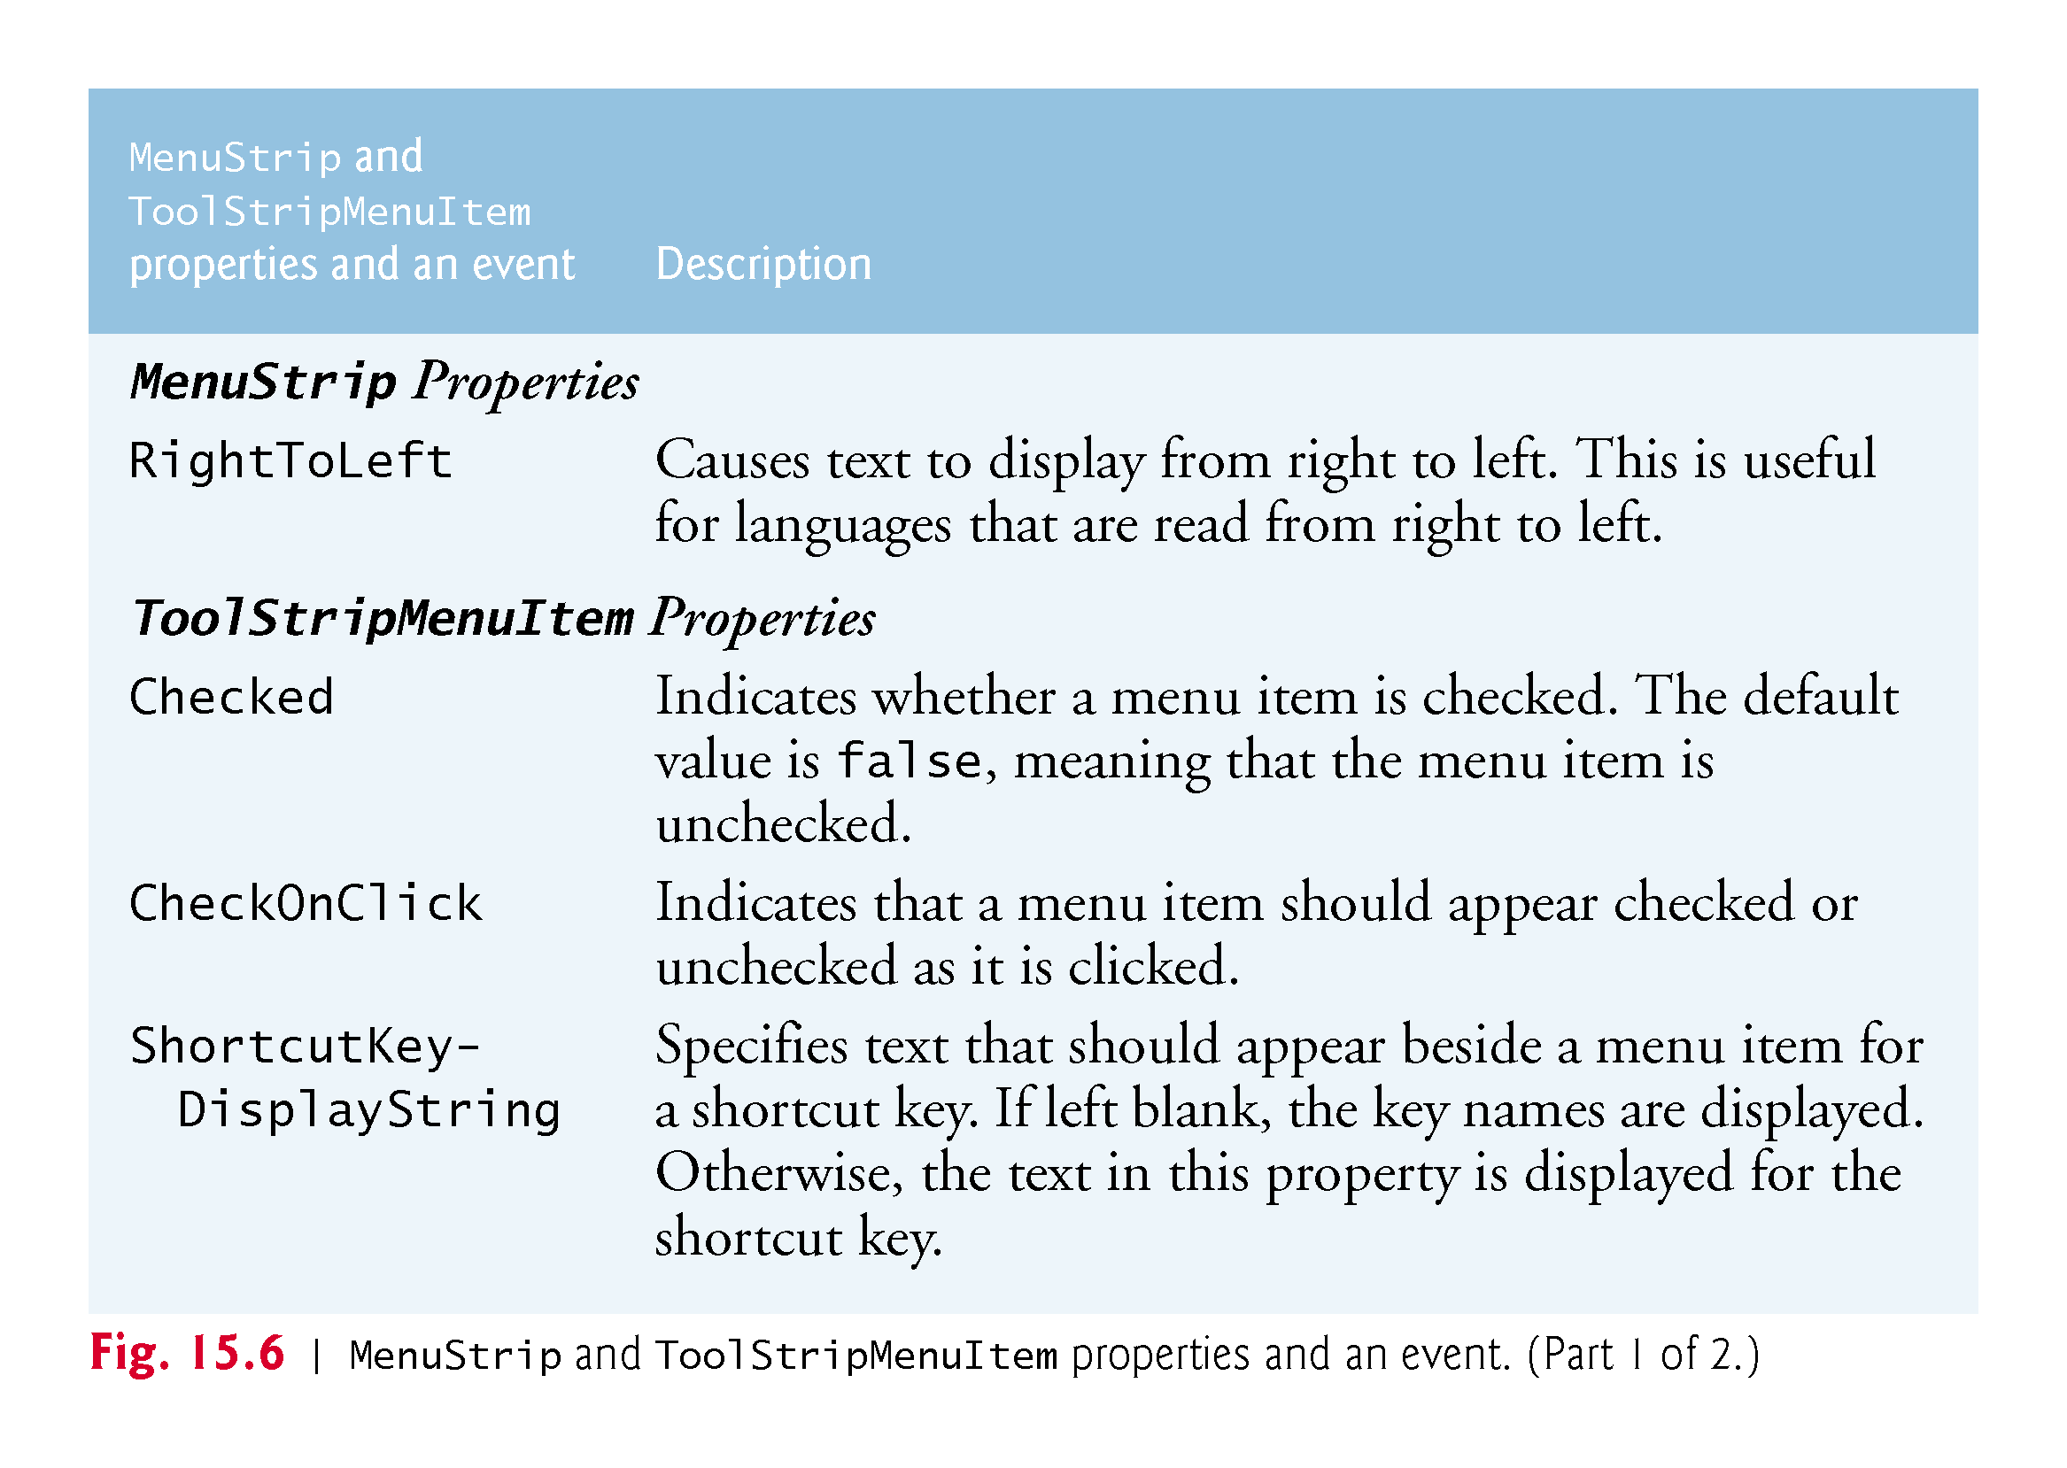

Slide 20
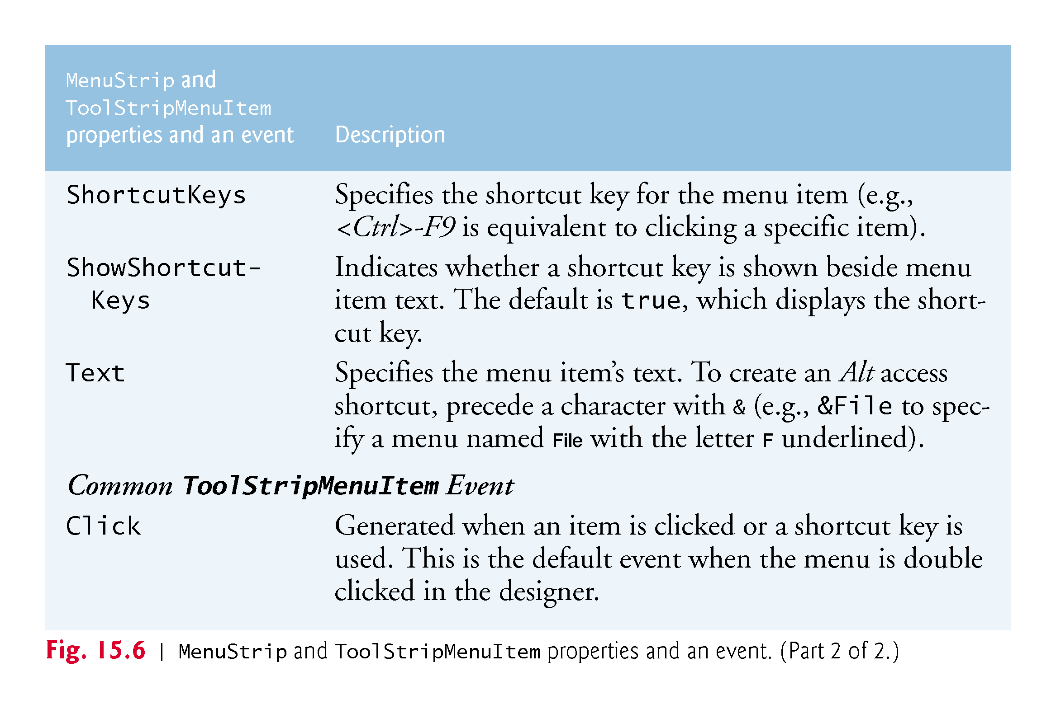

Slide 21
15.2 Menus (Cont.)
Class MenuTestForm (Fig. 15.7) creates a simple menu on a Form.

Slide 22
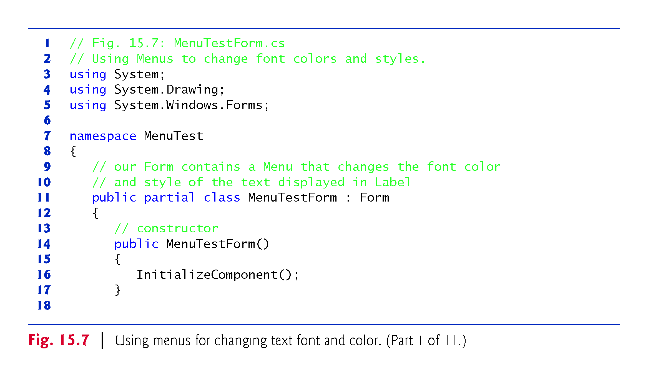

Slide 23
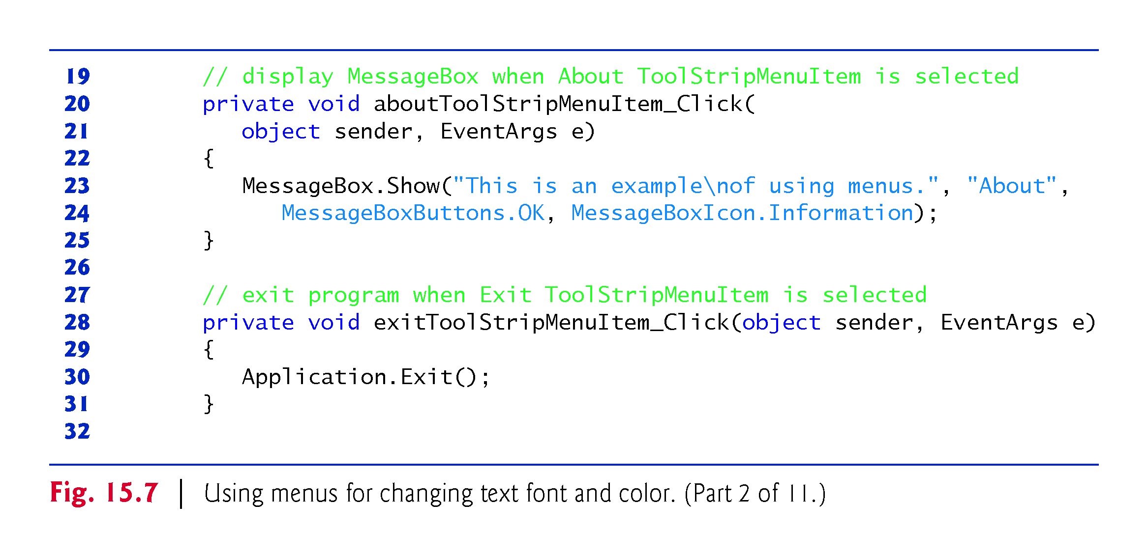

Slide 24
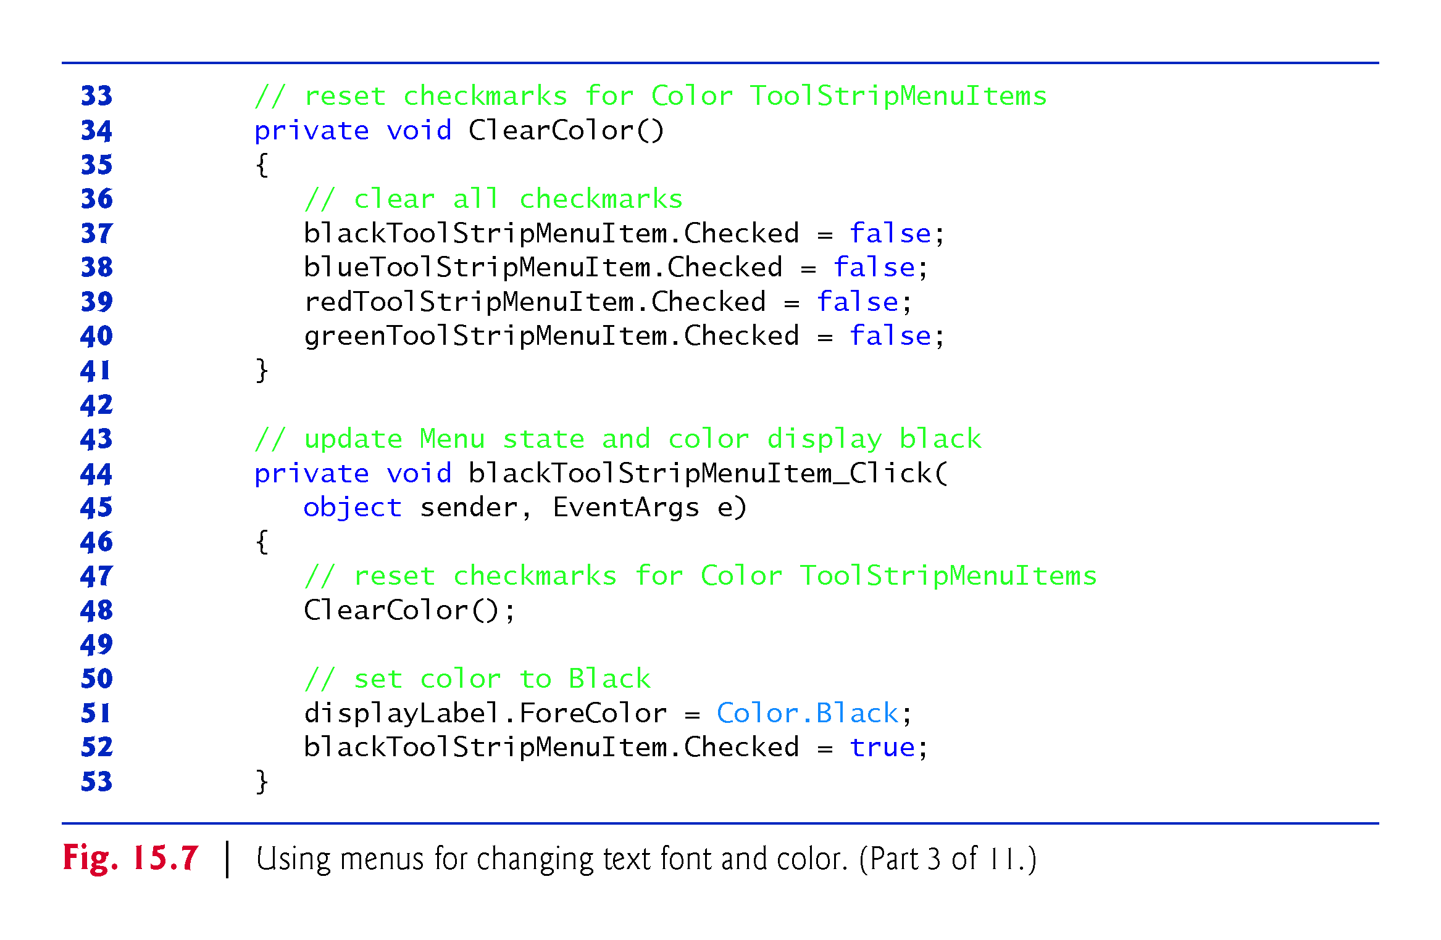

Slide 25
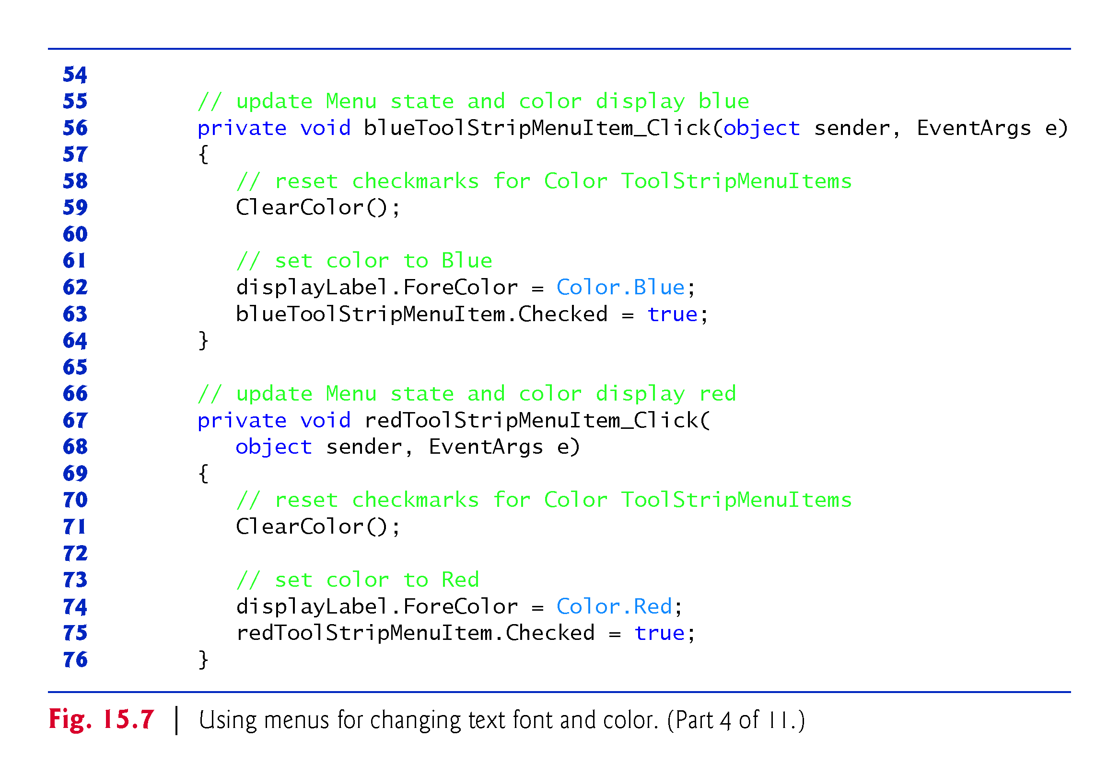

Slide 26
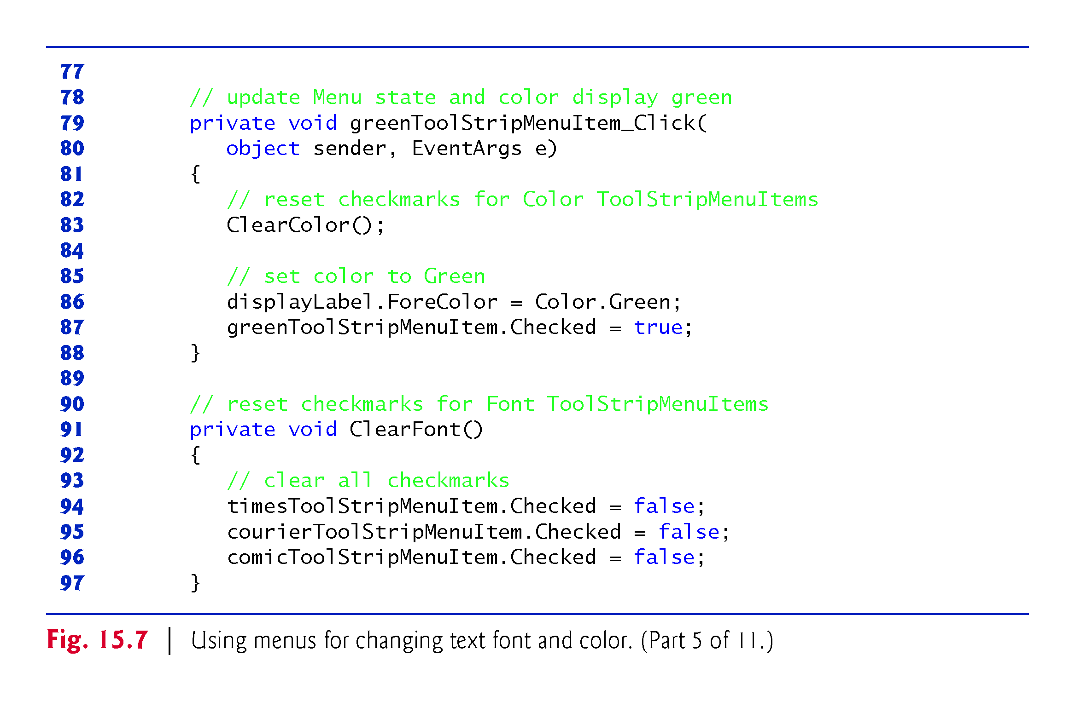

Slide 27
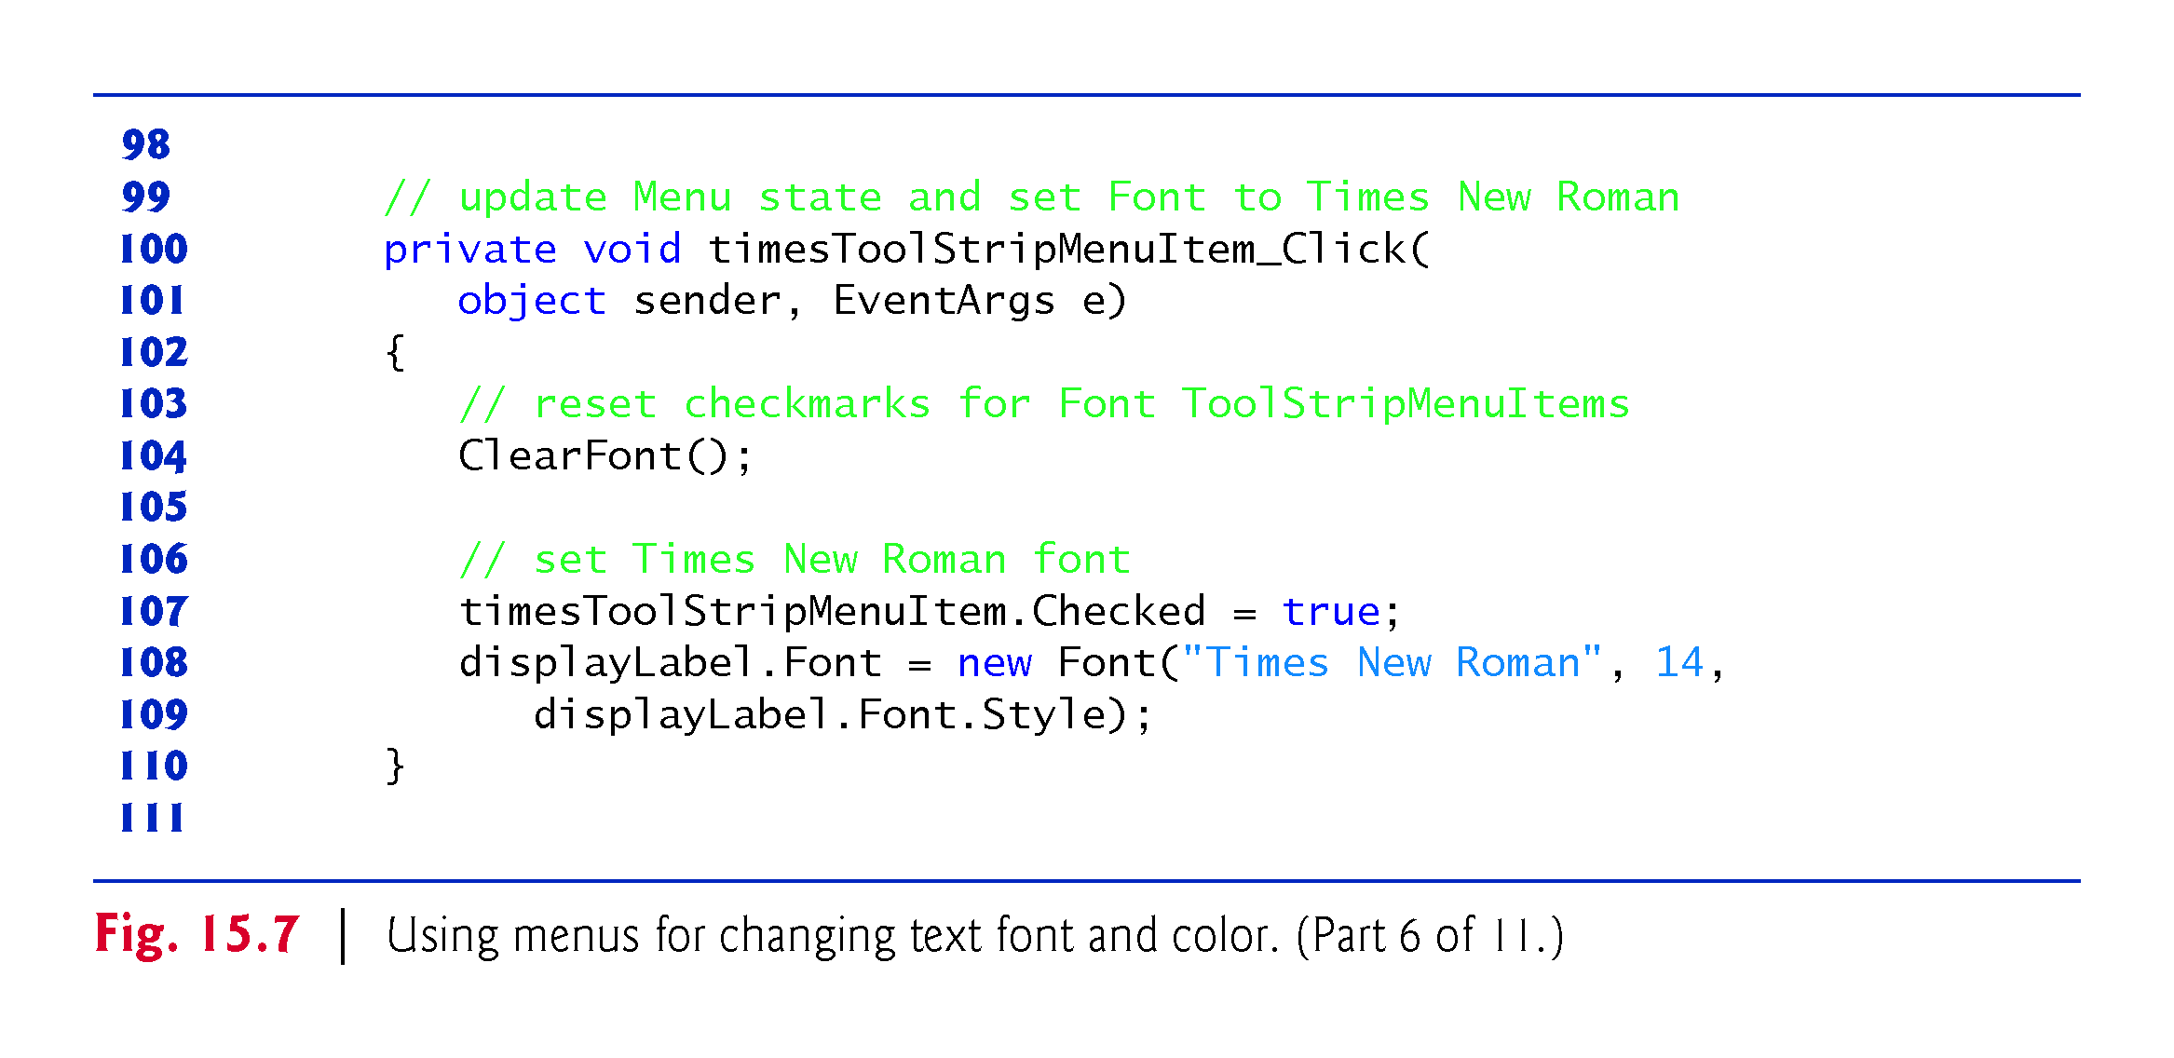

Slide 28
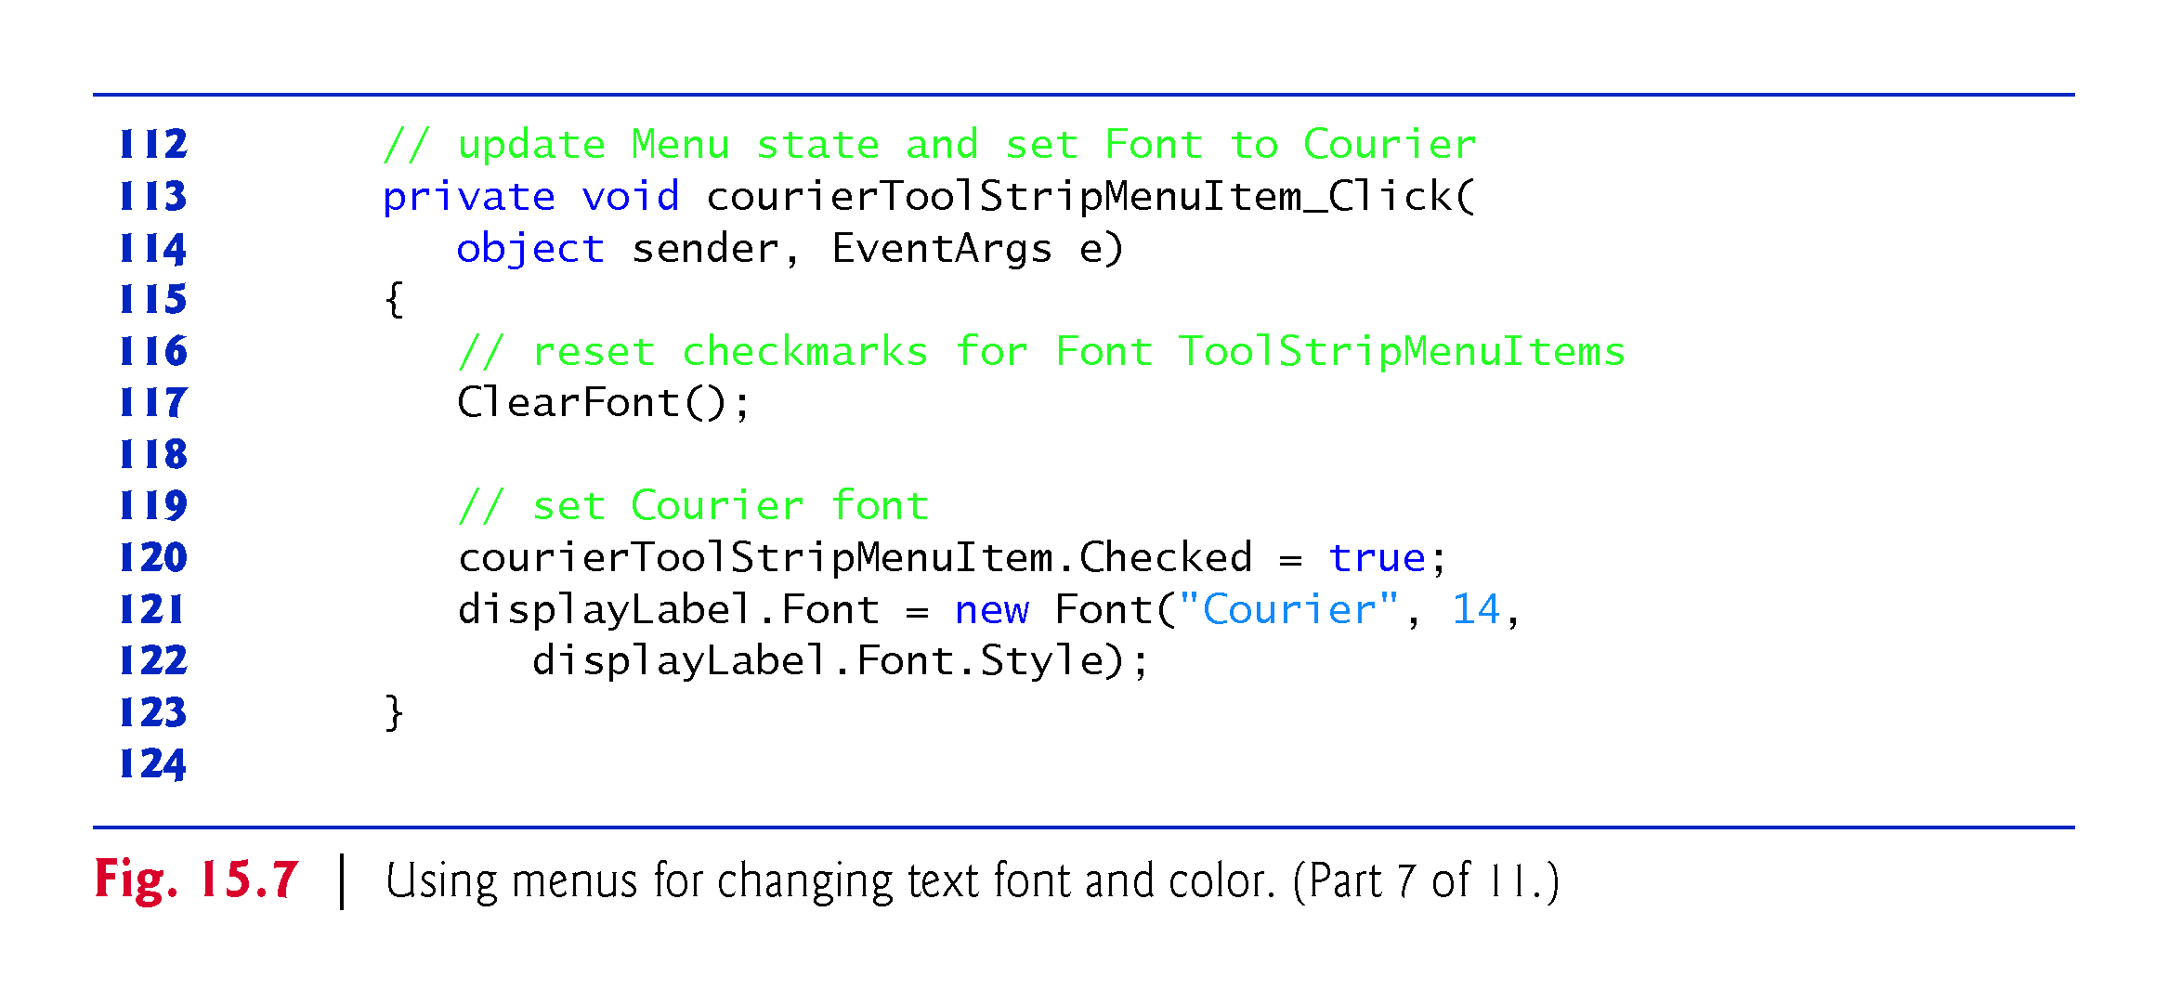

Slide 29
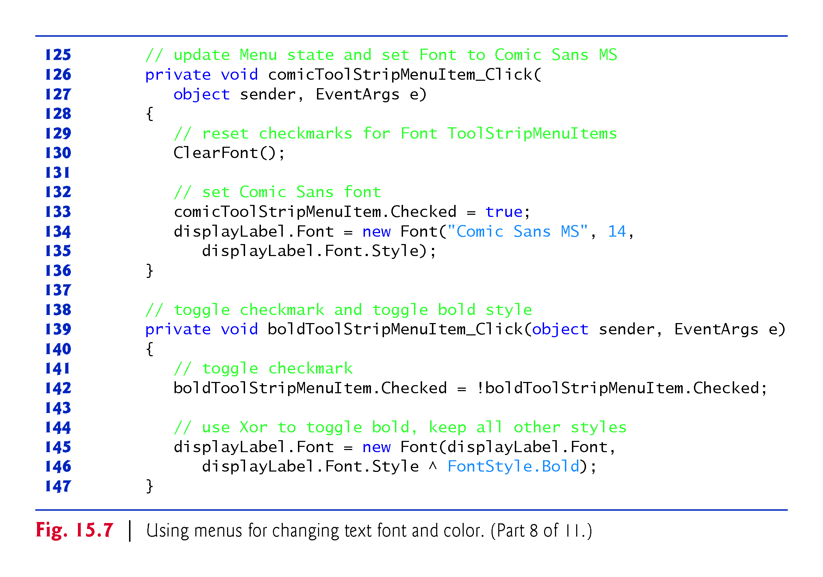

Slide 30
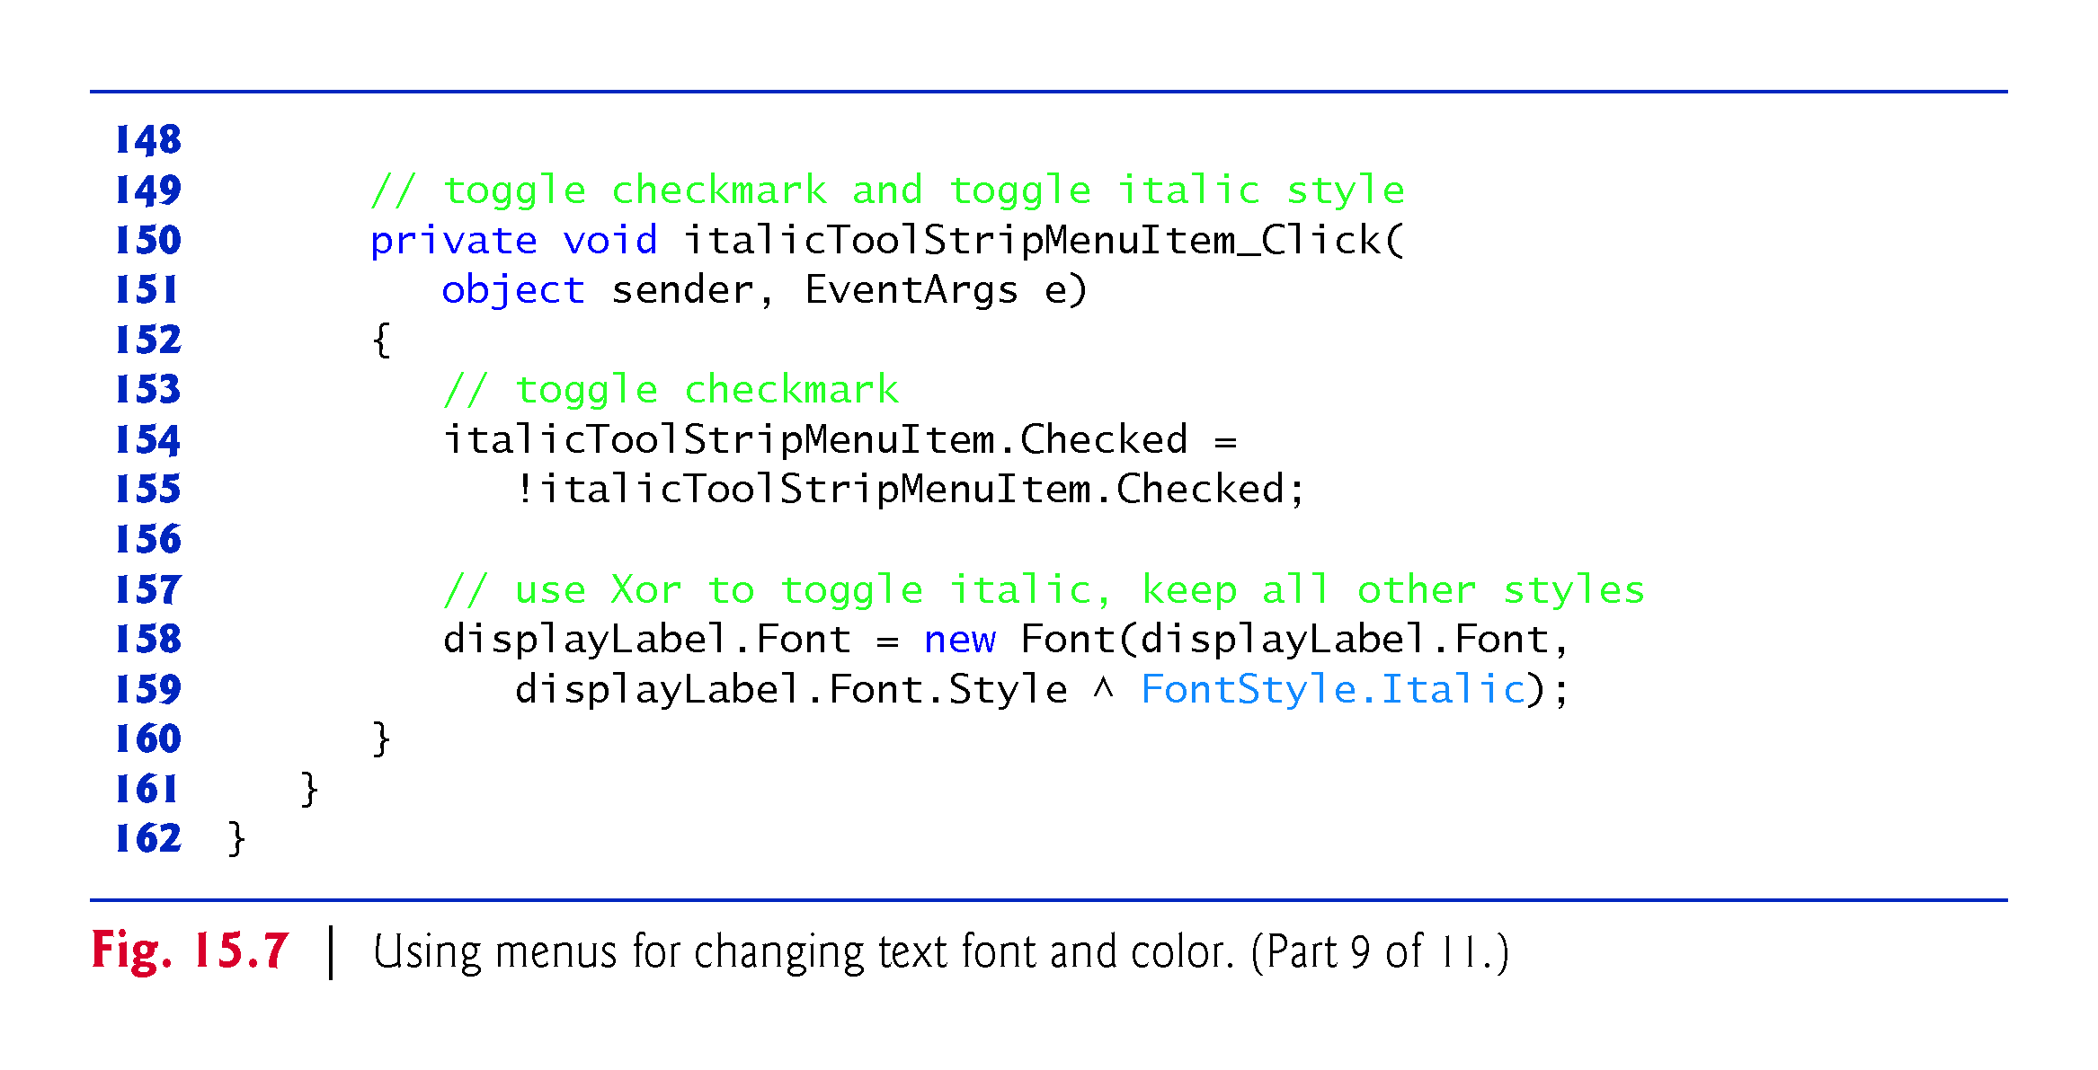

Slide 31
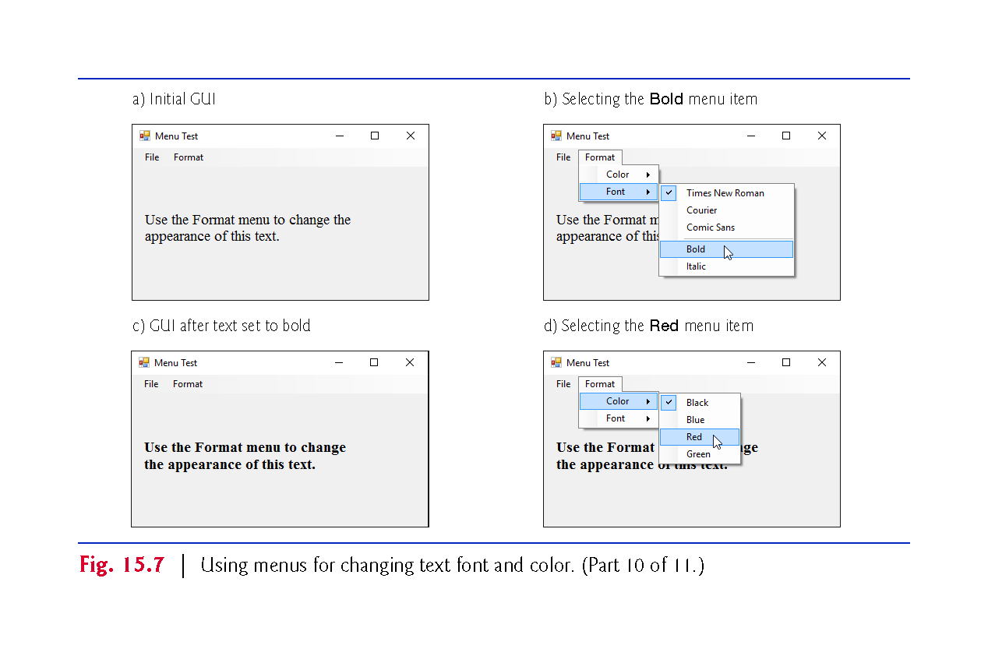

Slide 32
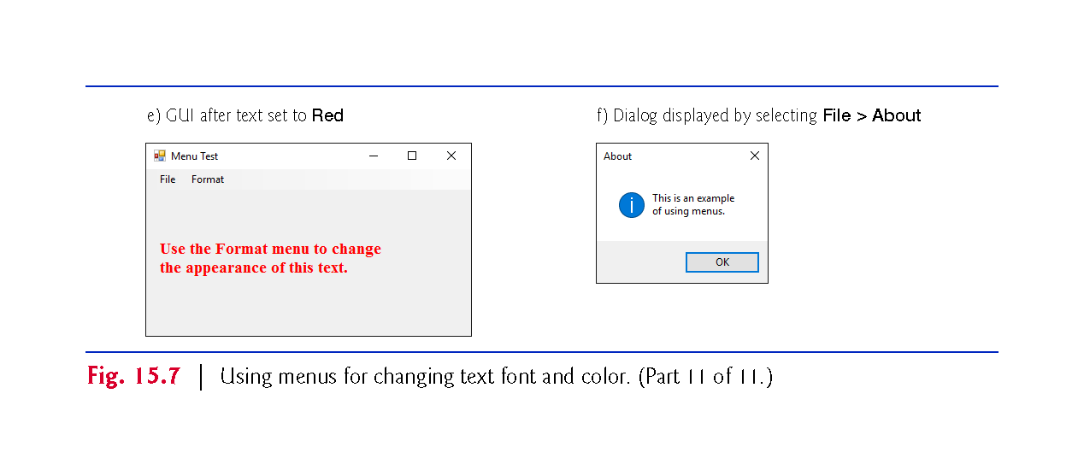

Slide 36
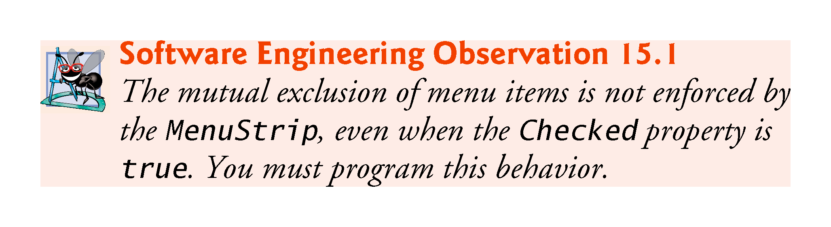

Slide 37
15.3 MonthCalendar Control
The MonthCalendar control (Fig. 15.8) displays a monthly calendar on the Form.
Multiple dates can be selected by clicking dates on the calendar while holding down the Shift key.

Slide 38
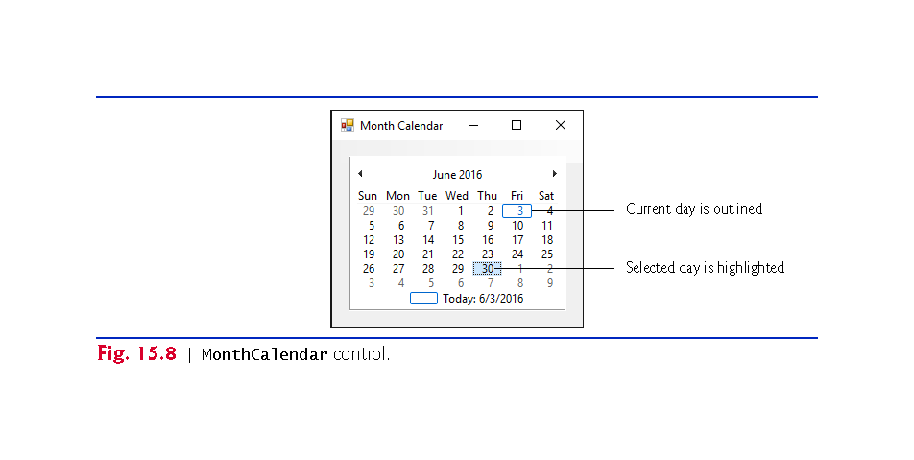

Slide 39
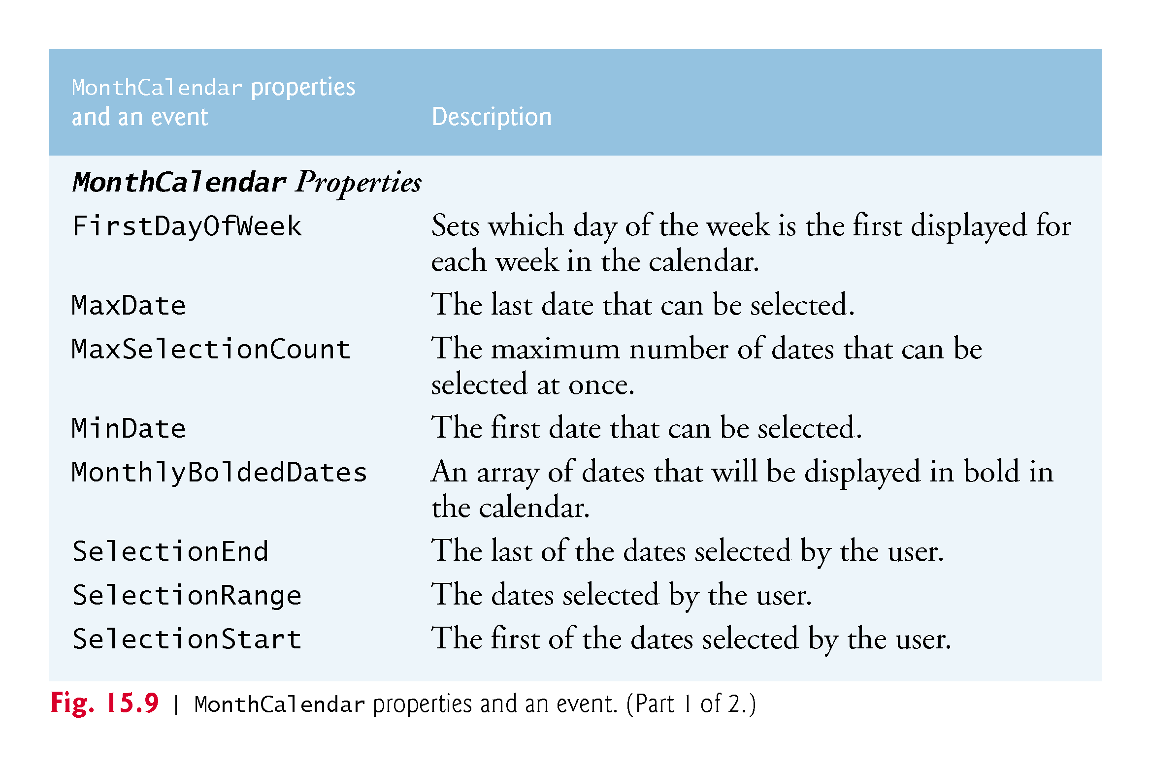

Slide 40
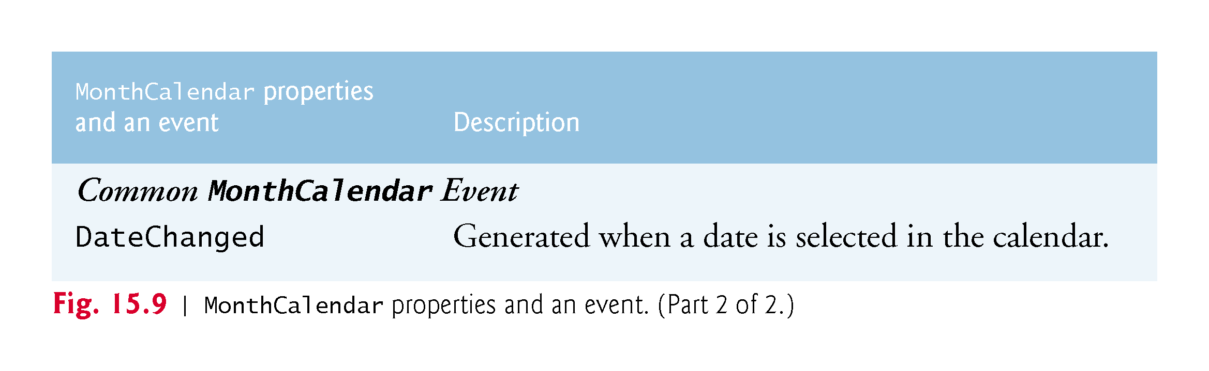

Slide 41
15.4 DateTimePicker Control
The DateTimePicker control displays a calendar when a down arrow is selected.
The DateTimePicker can be used to retrieve date and time information from the user.

Slide 42
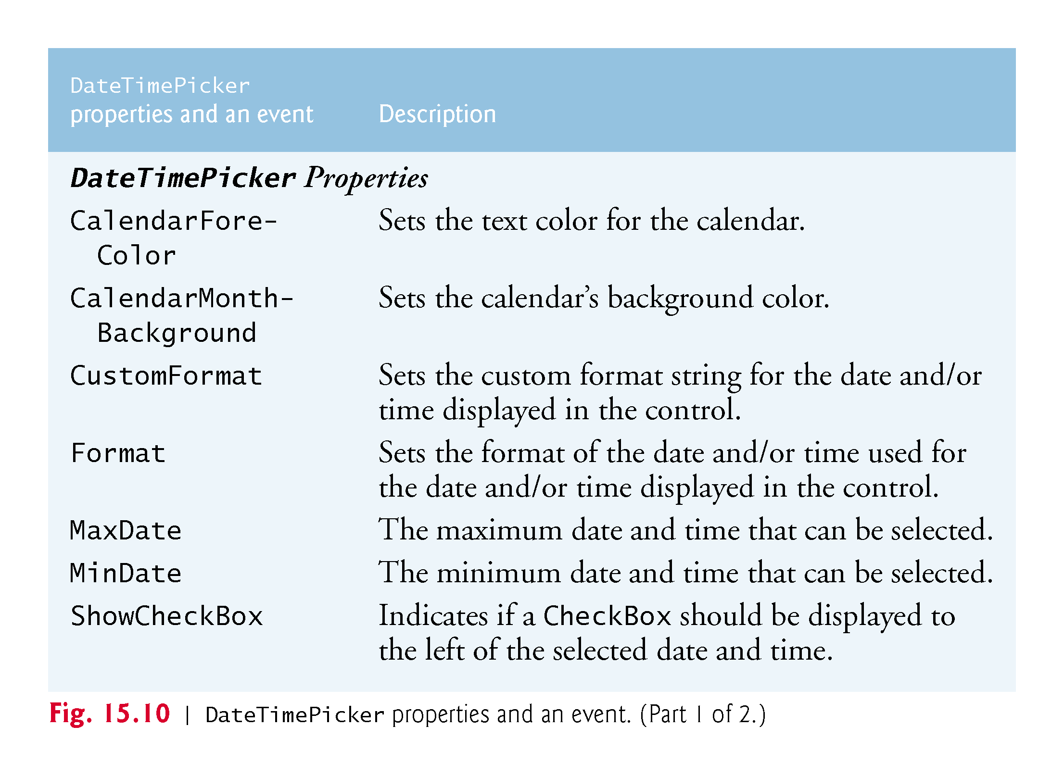

Slide 43
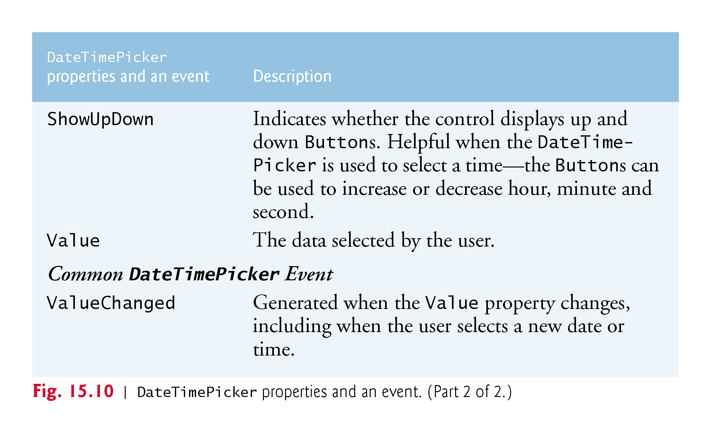

Slide 44
15.4 DateTimePicker Control (cont.)
Figure 15.11 demonstrates using the DateTimePicker control to select an item’s drop-off time.
The DateTimePicker has its Format property set to Long.
In this app, the arrival date is always two days after drop-off, or three days if a Sunday is reached.

Slide 45
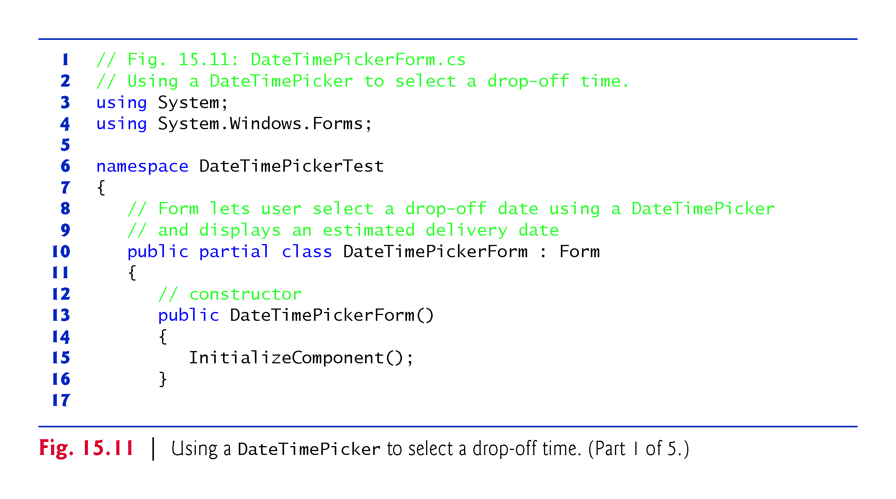

Slide 46
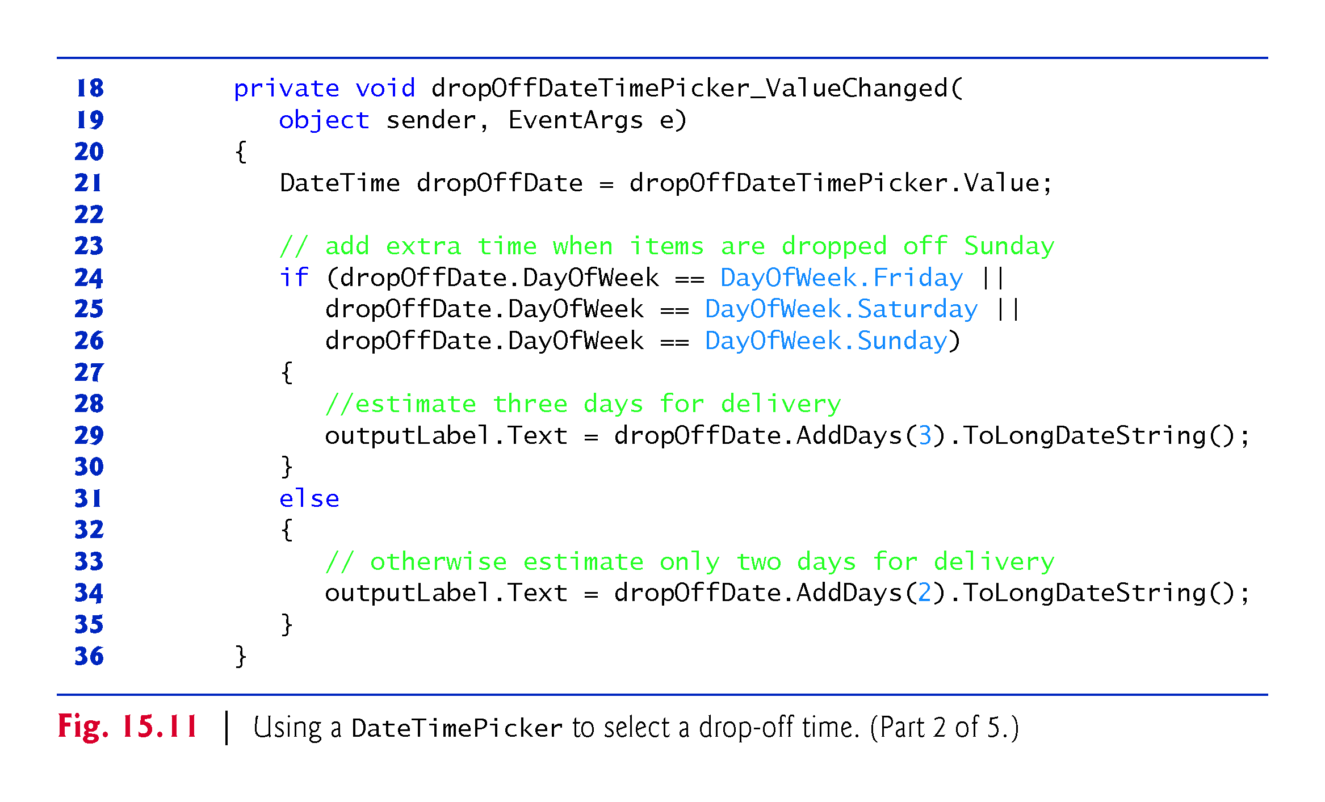

Slide 47
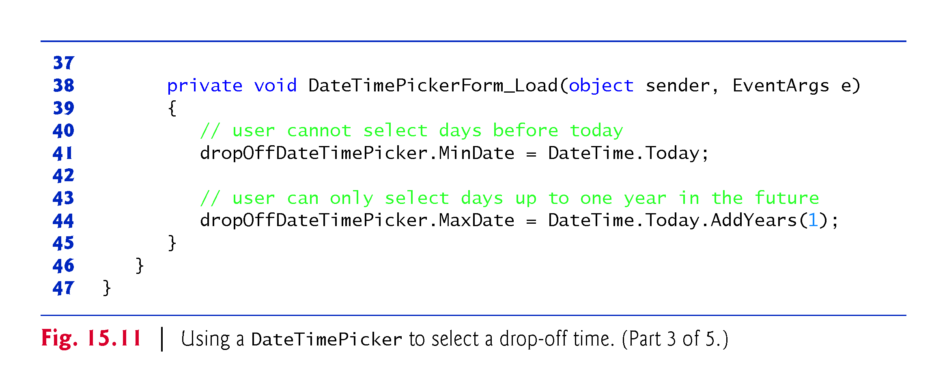

Slide 48
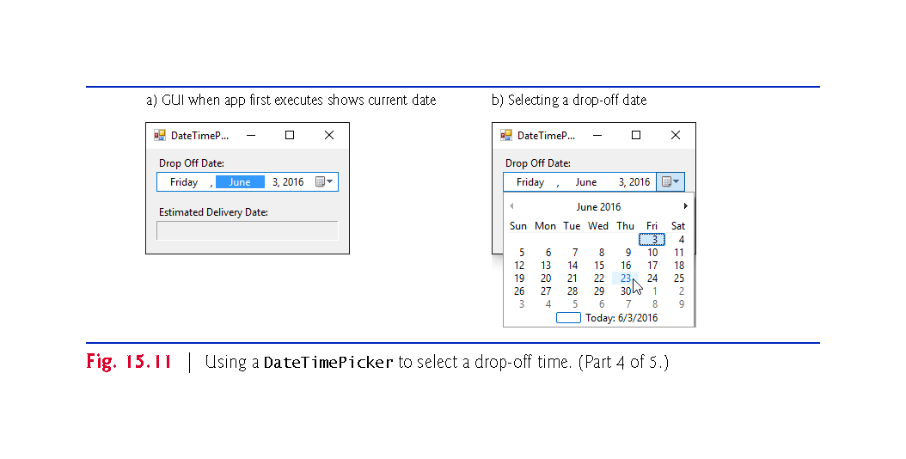

Slide 49
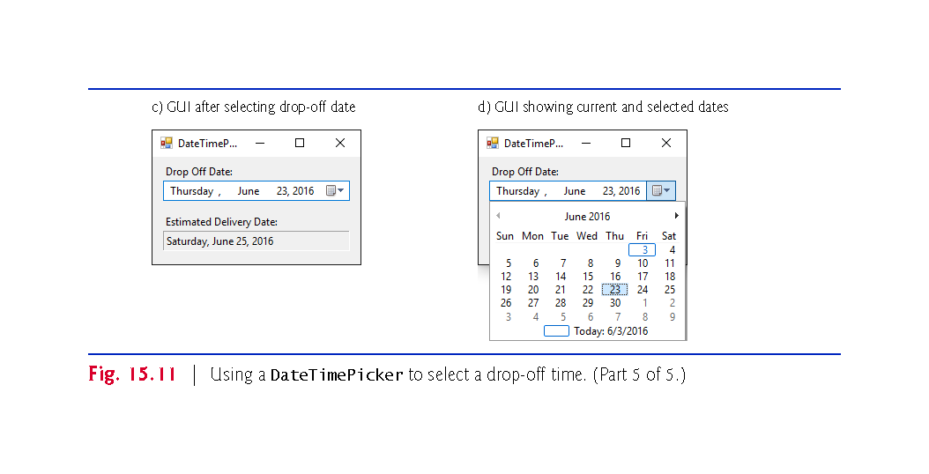

Slide 50
15.5 LinkLabel Control
The LinkLabel control displays links to other resources, such as files or web pages (Fig. 15.12).

Slide 51
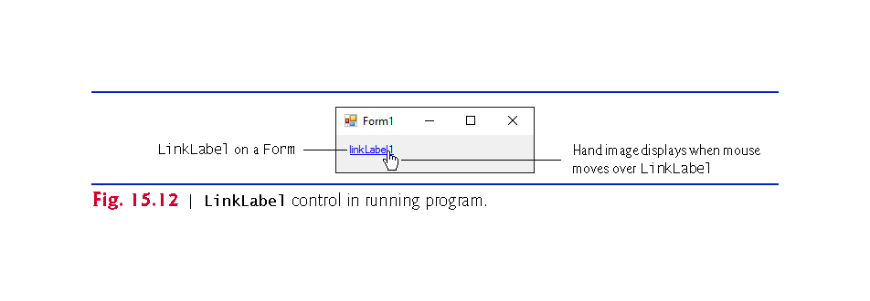

Slide 52
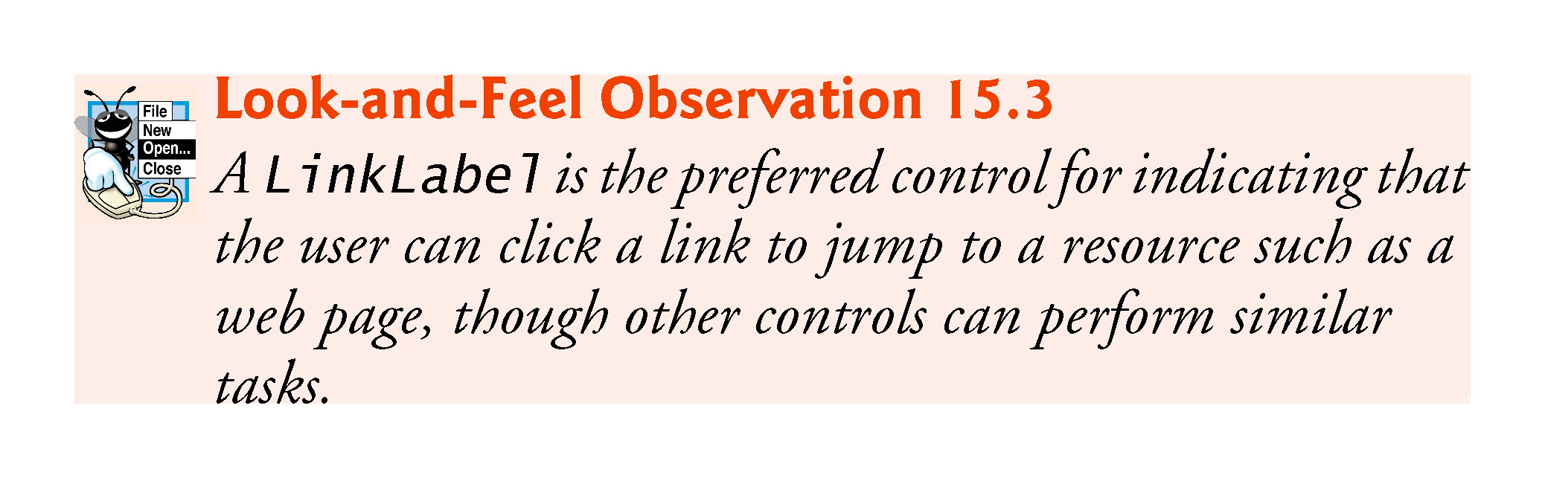

Slide 53
15.5 LinkLabel Control (Cont.)
When clicked, the LinkLabel generates a LinkClicked event (Fig. 15.13).
Class LinkLabel is derived from class Label and therefore inherits all of class Label’s functionality.

Slide 54
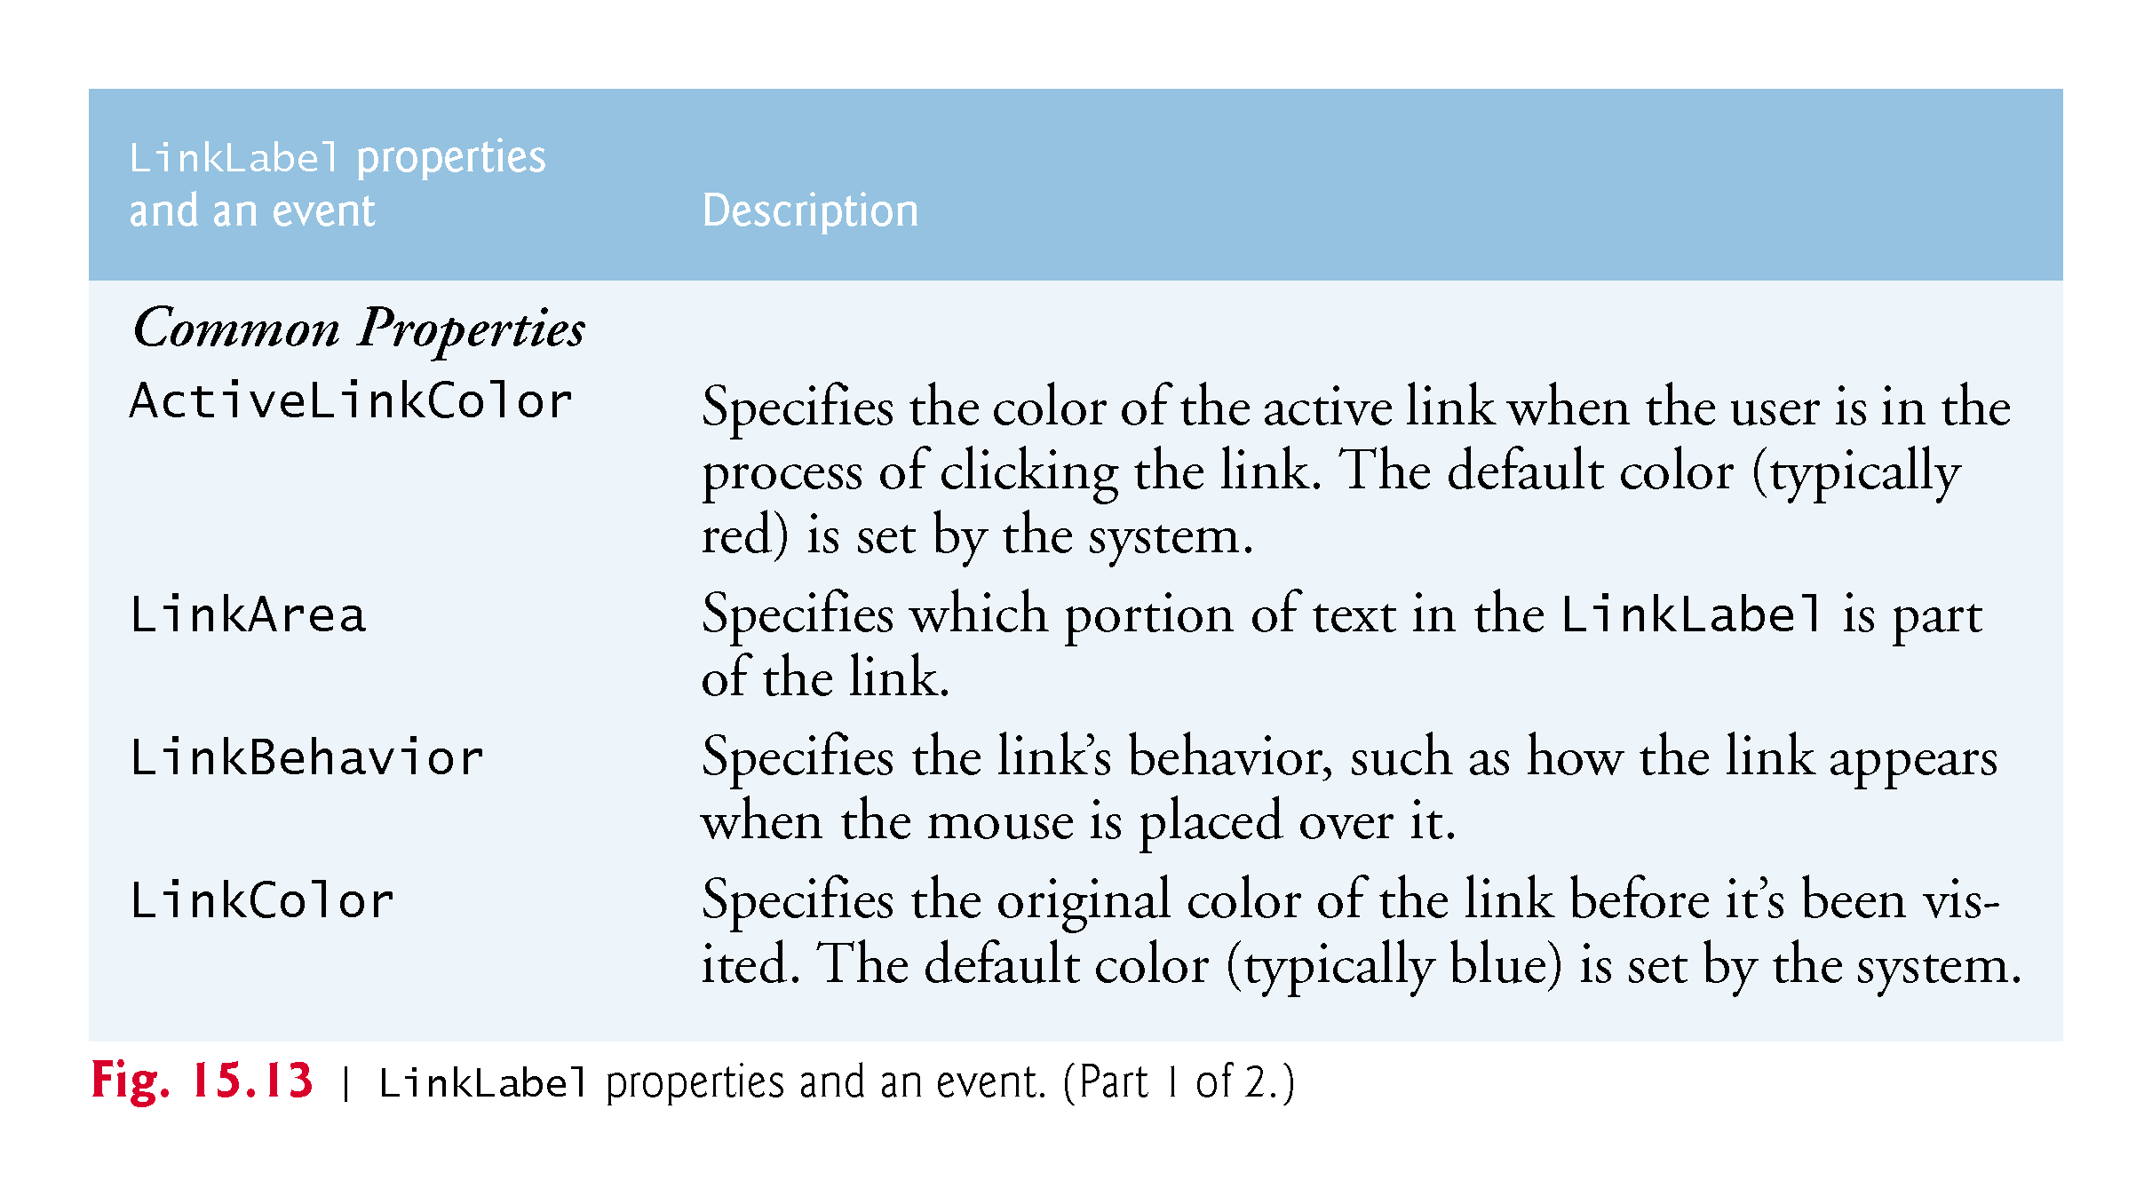

Slide 55
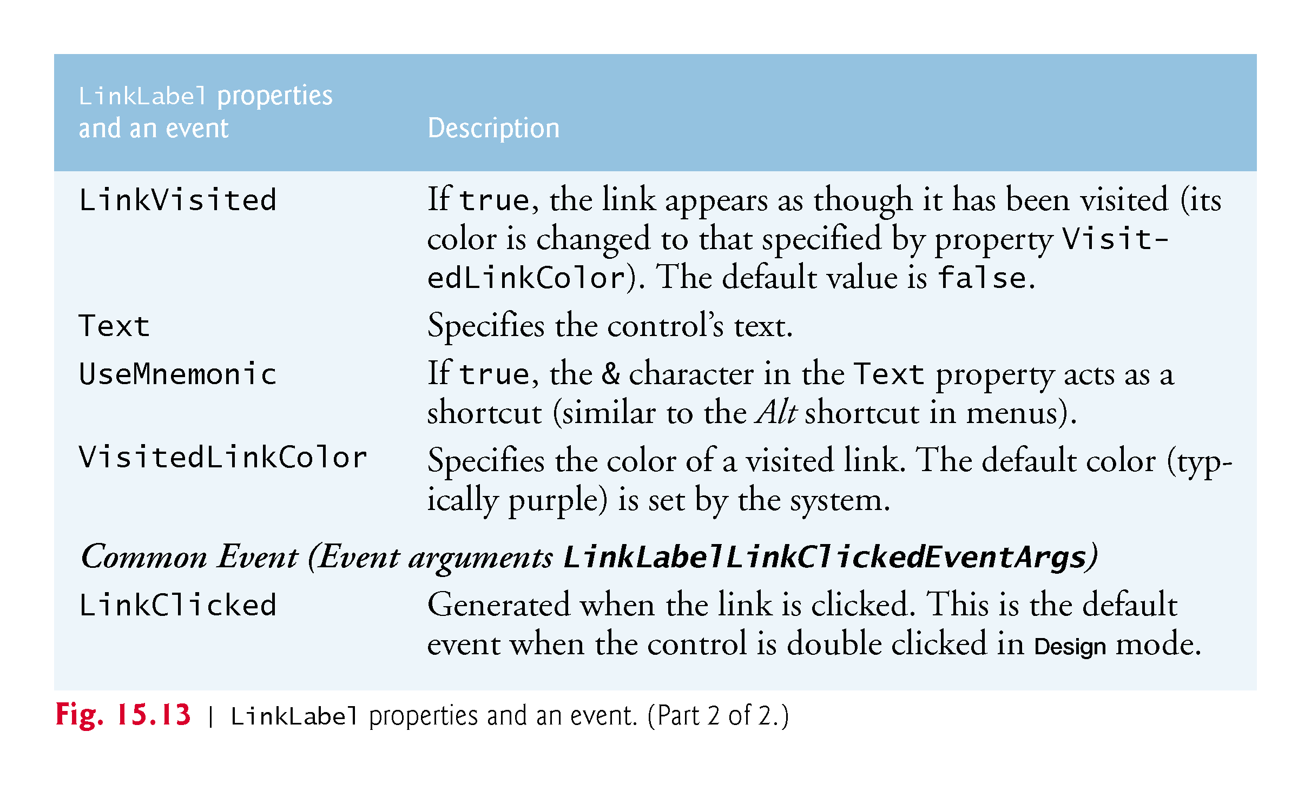

Slide 56
15.5 LinkLabel Control (Cont.)
Class LinkLabelTestForm (Fig. 15.14) uses three LinkLabels.
Method Start of class Process allows you to execute other programs, or load documents or web sites from an app.

Slide 57
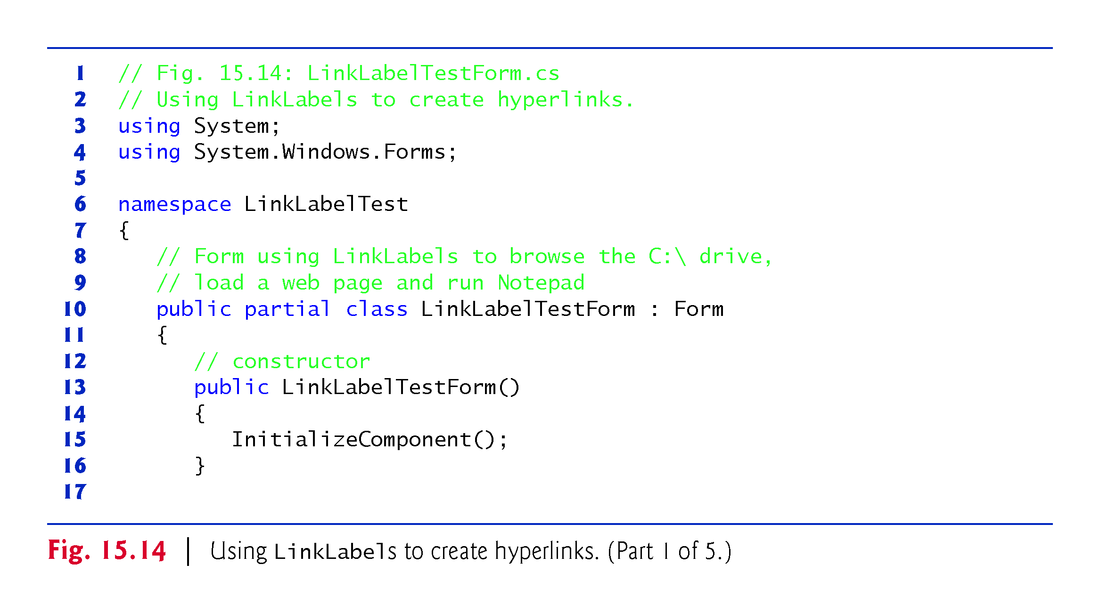

Slide 58
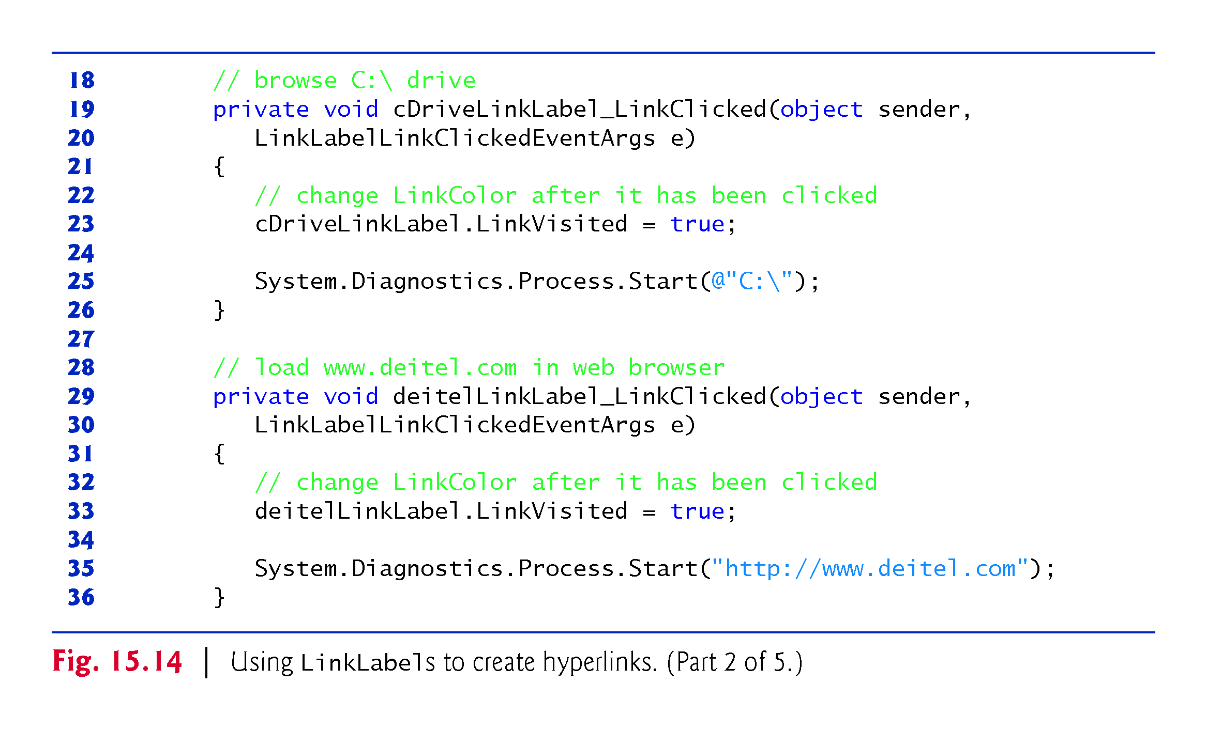

Slide 59
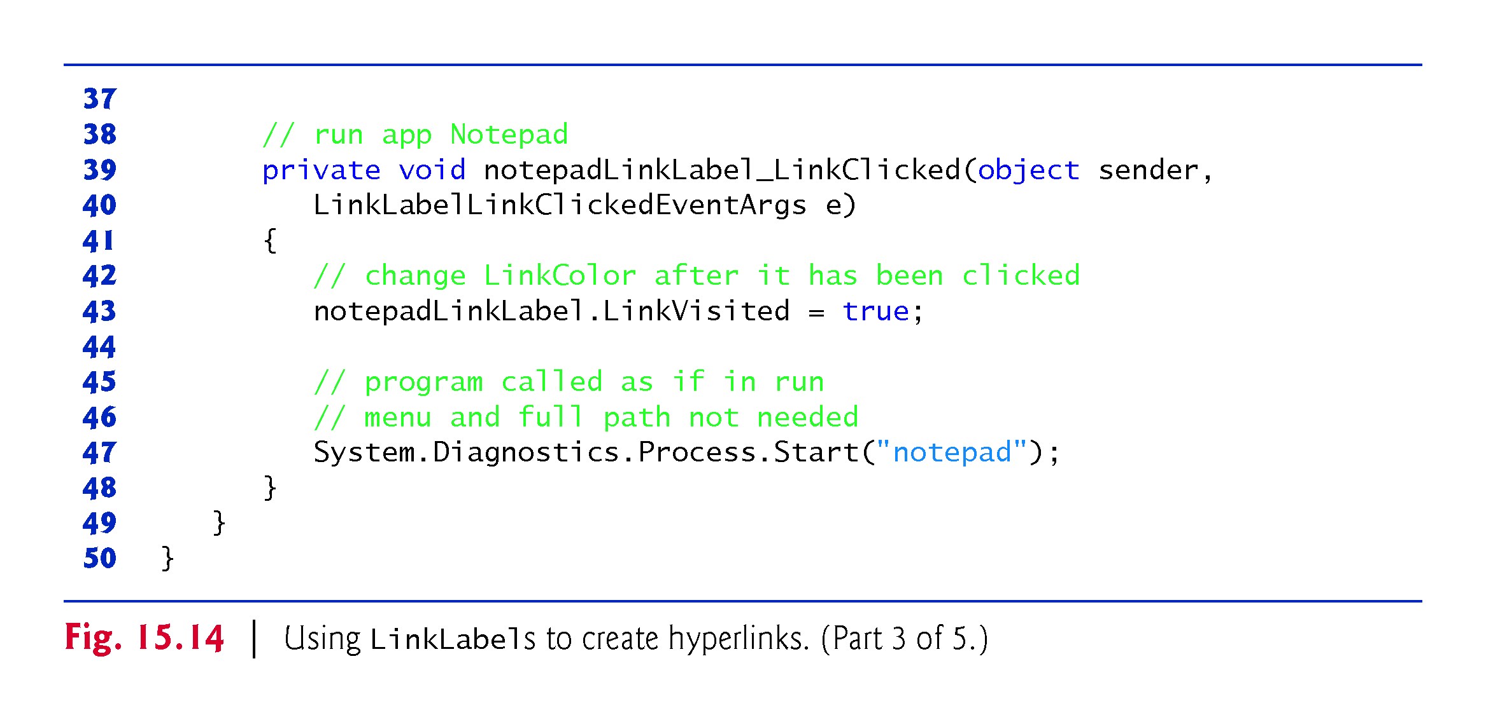

Slide 60
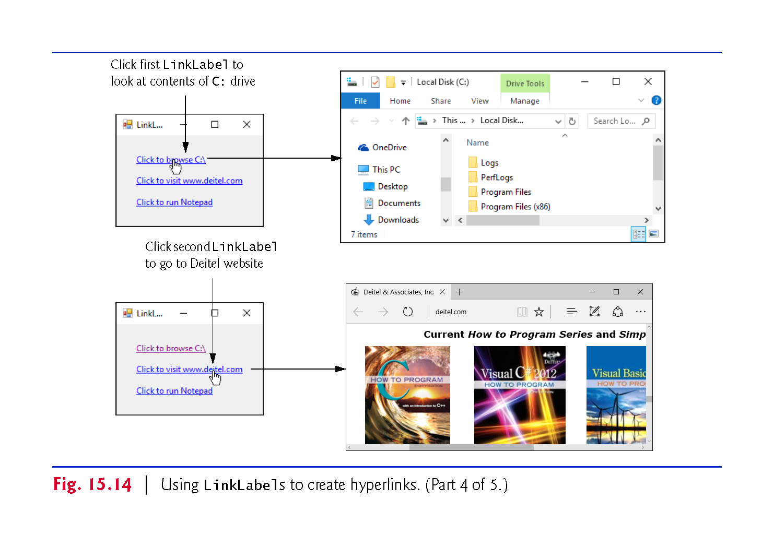

Slide 61
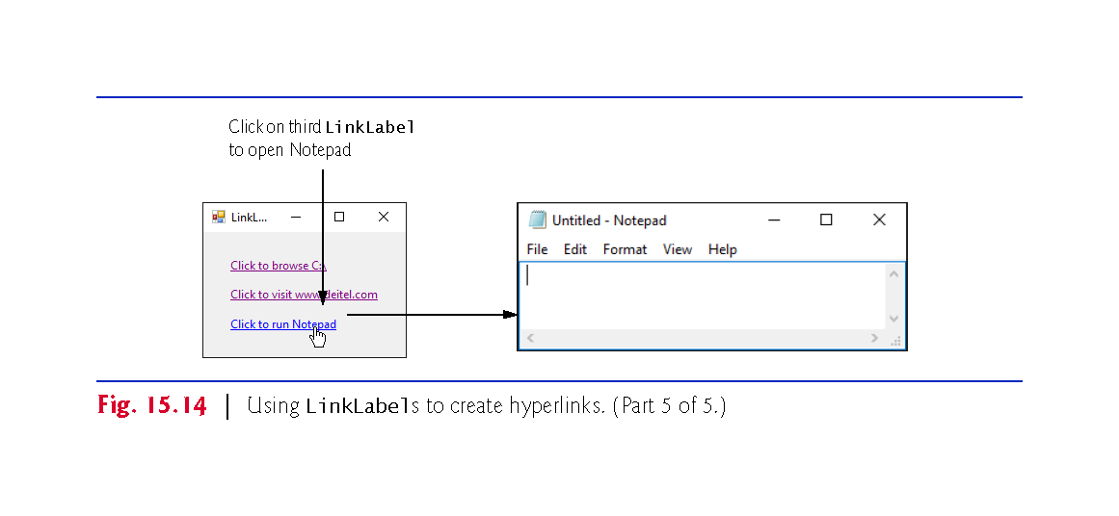

Slide 62
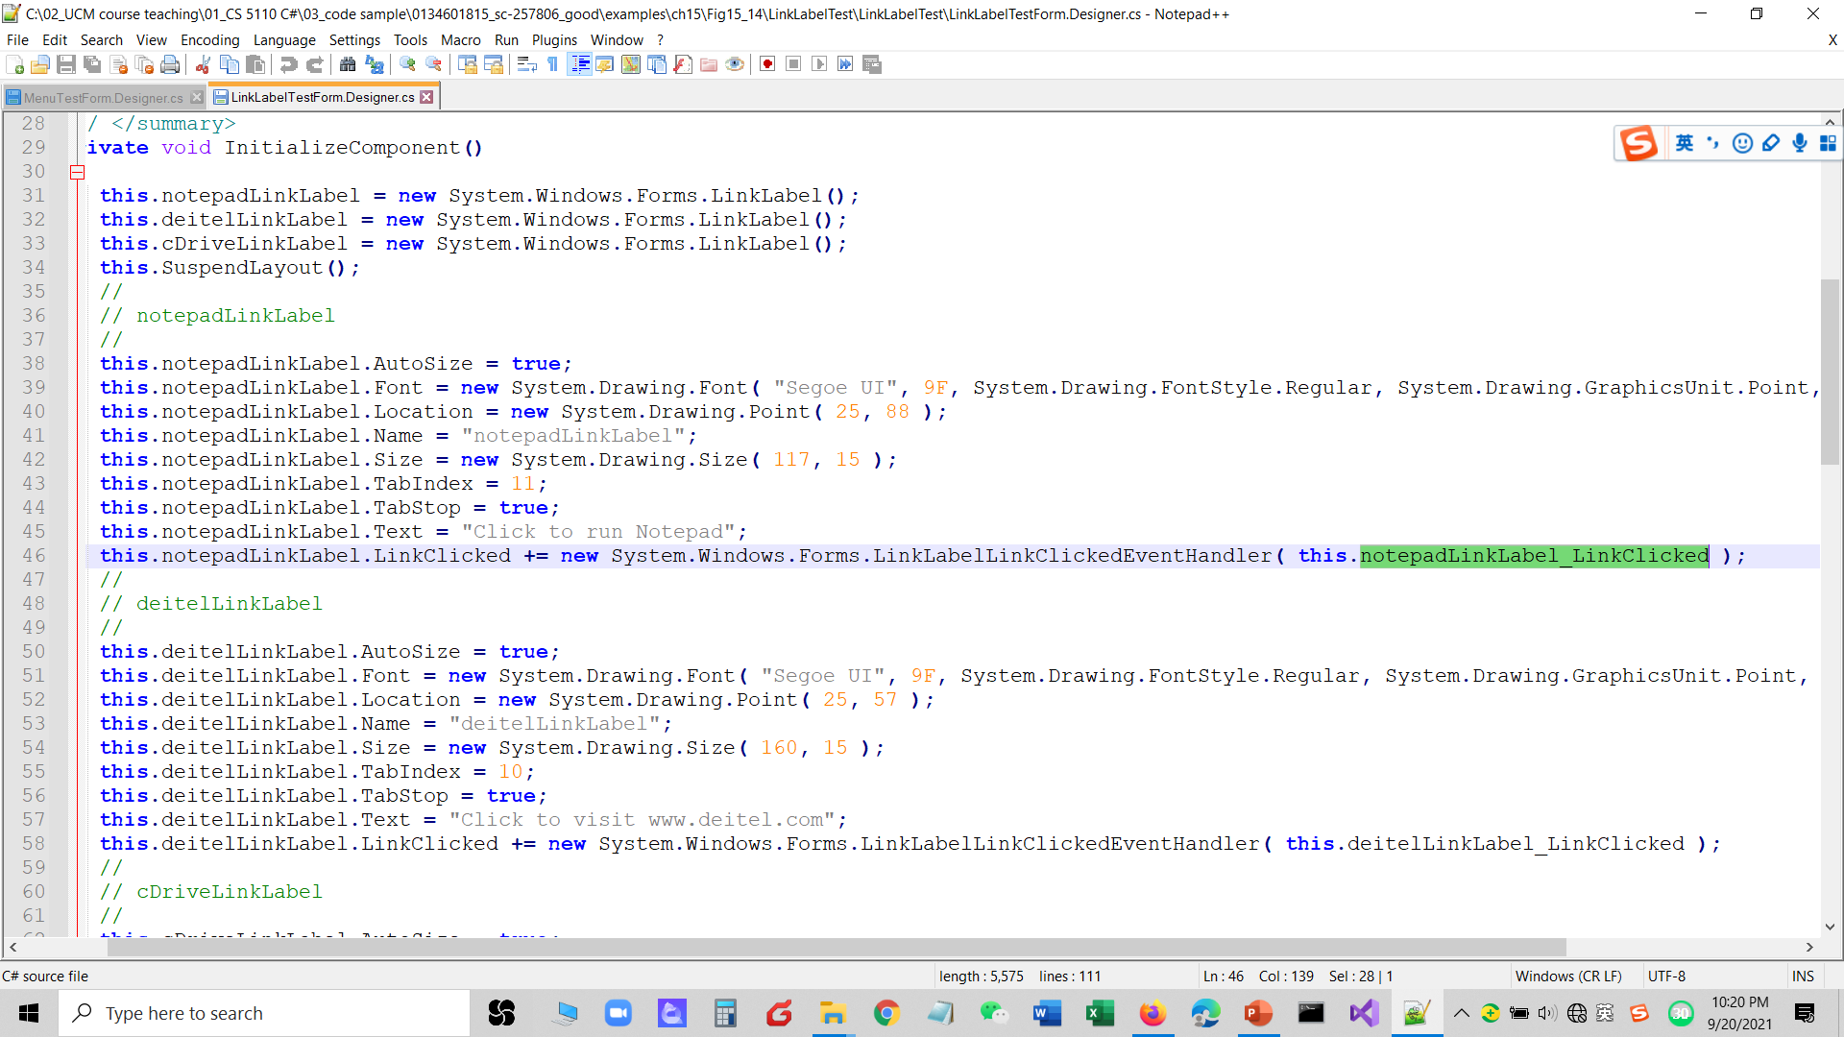

Slide 63
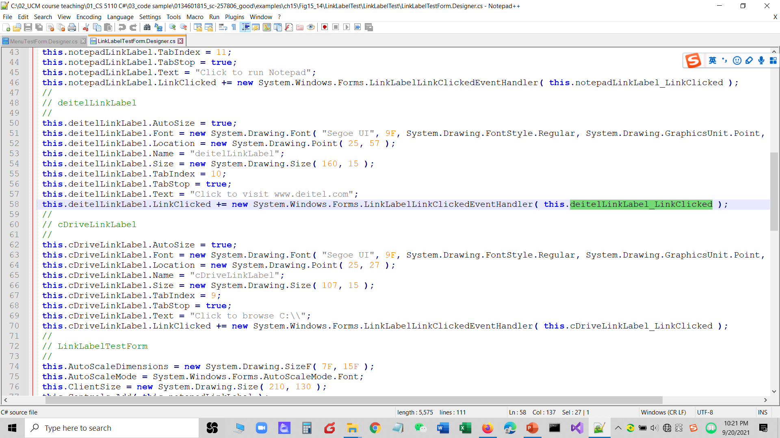

Slide 64
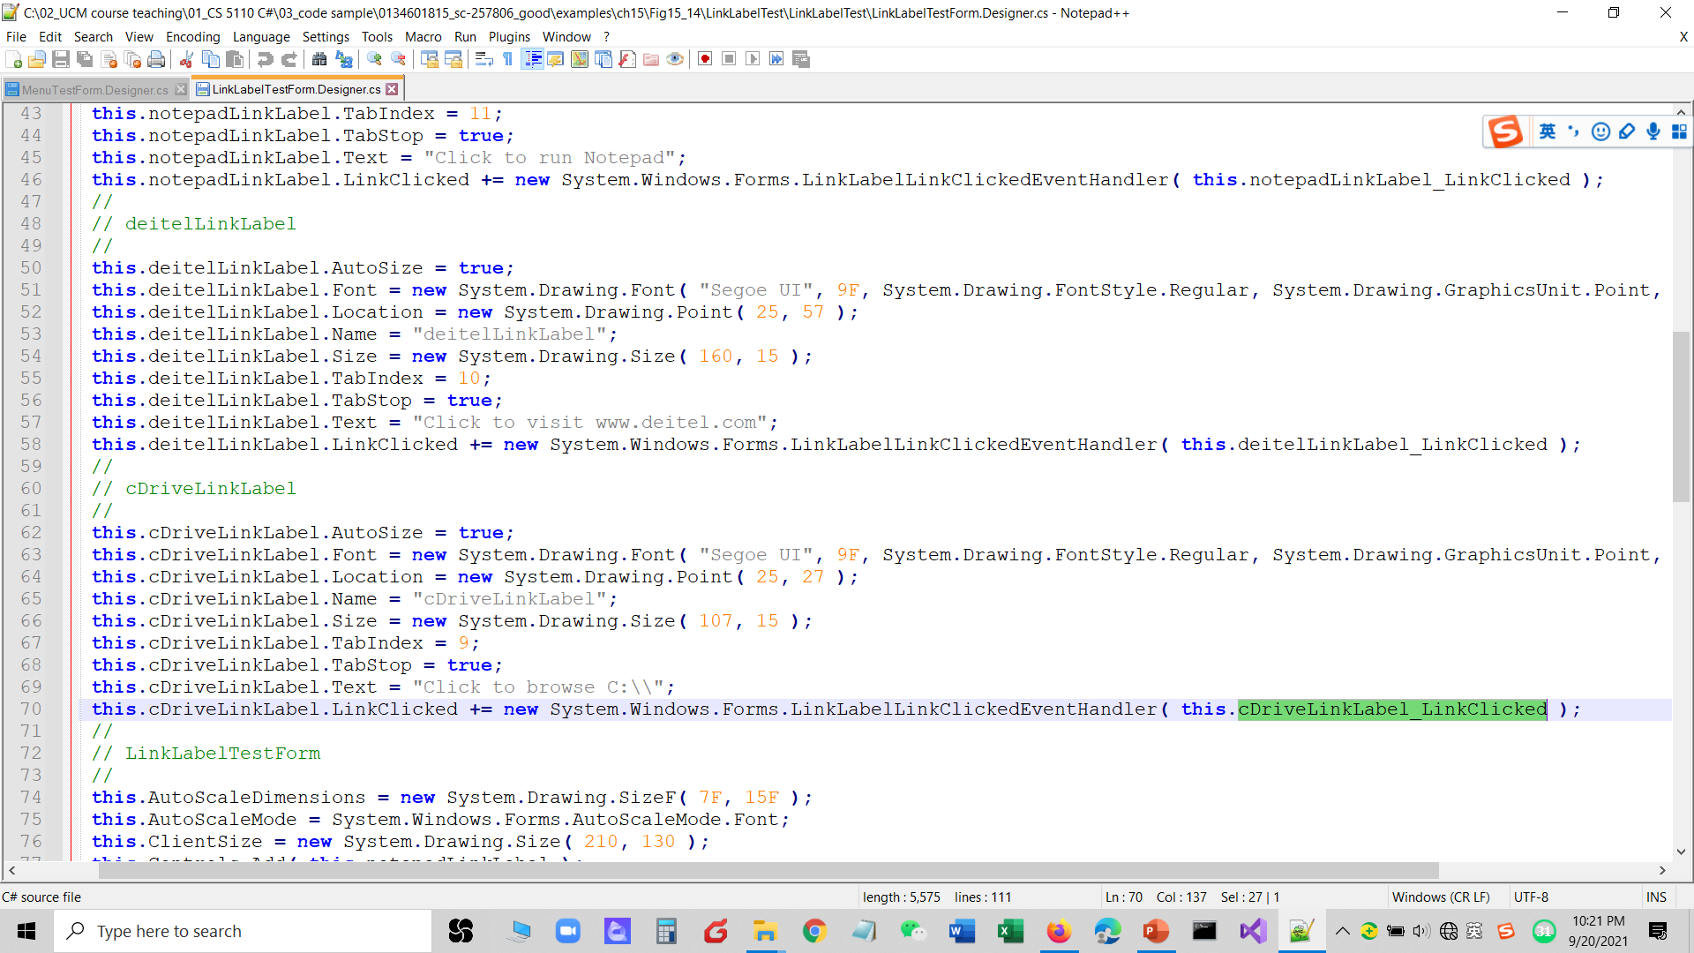

Slide 65
15.6 ListBox Control
The ListBox control allows the user to view and select from multiple items in a list.
The CheckedListBox control extends a ListBox by including CheckBoxes next to each item in the list.
Figure 15.15 displays a ListBox and a CheckedListBox.

Slide 66
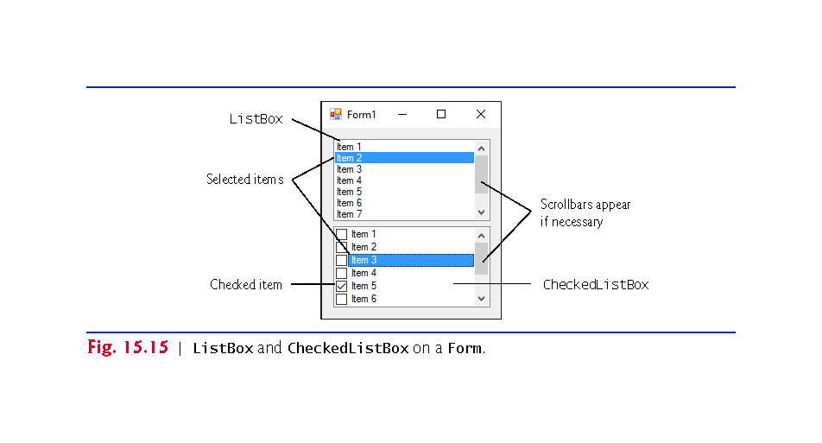

Slide 67
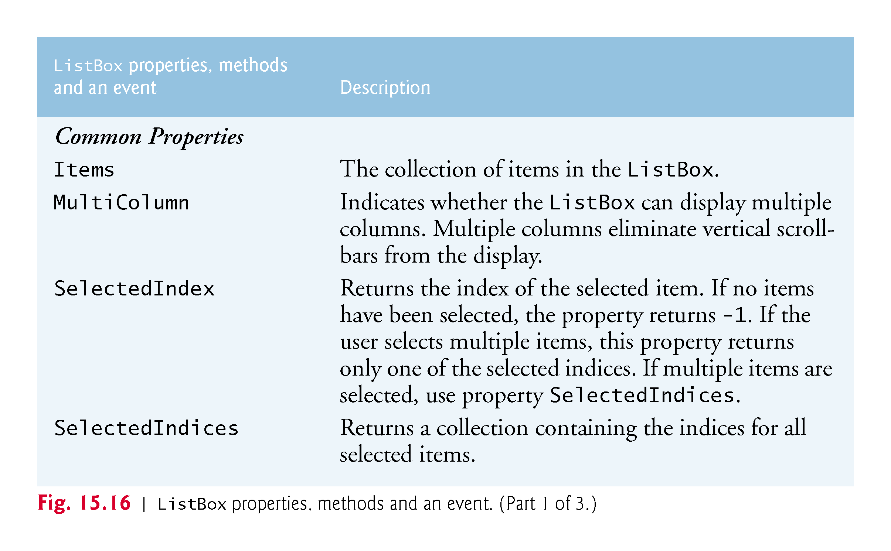

Slide 68
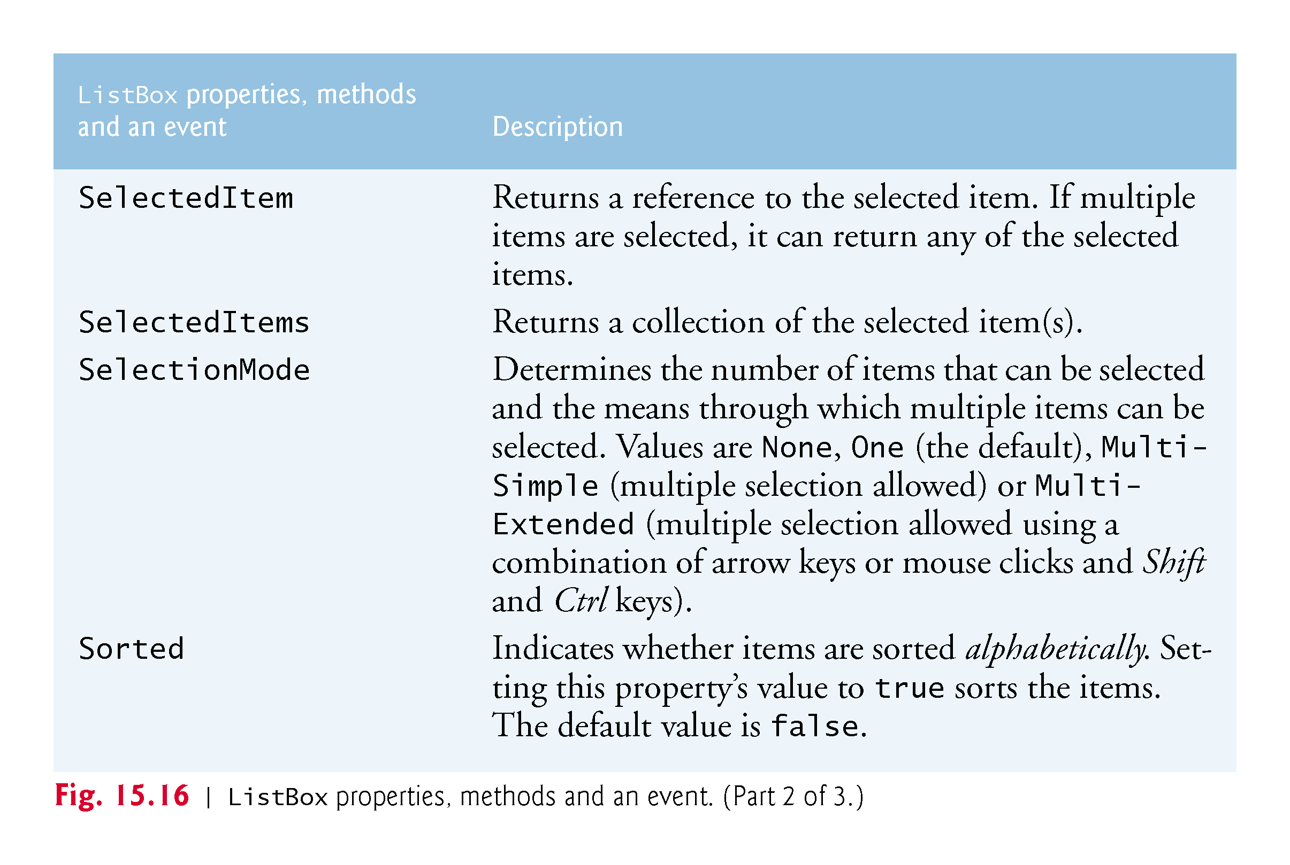

Slide 69
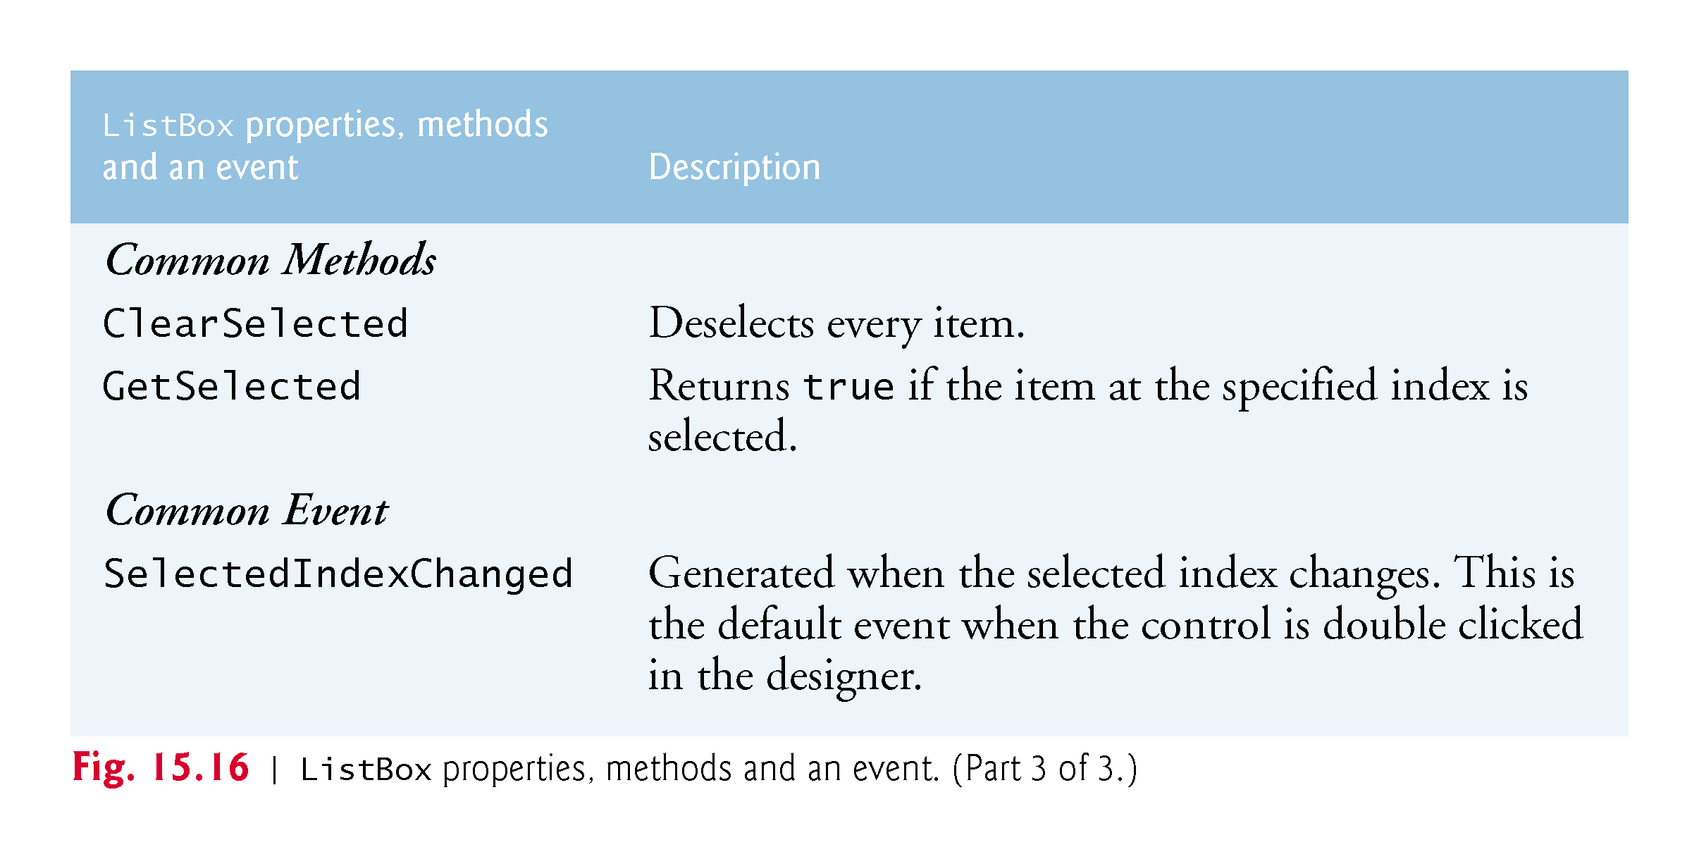

Slide 70
15.6 ListBox Control (Cont.)
Adding Items to ListBoxes and CheckedListBoxes
To add items to a ListBox or to a CheckedListBox, we must add objects to its Items collection.
myListBox.Items.Add(myListItem);
You can add items to ListBoxes and CheckedListBoxes visually by examining the Items property in the Properties window (Fig. 15.17).

Slide 71
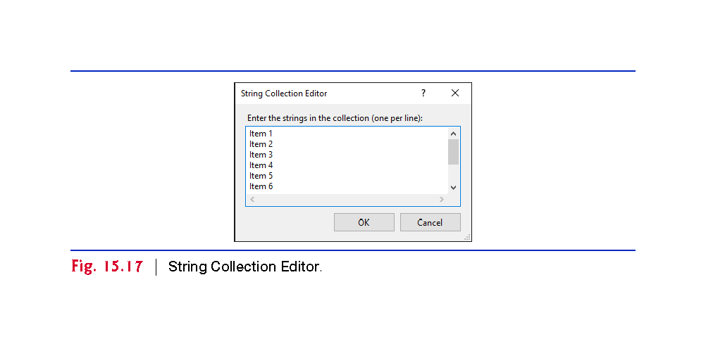

Slide 72
15.6 ListBox Control (Cont.)
Figure 15.18 uses class ListBoxTestForm to add, remove and clear items from ListBox displayListBox.

Slide 73


Slide 74


Slide 75


Slide 76


Slide 77


Slide 78
15.7 CheckedListBox Control
The CheckedListBox control derives from ListBox and displays a CheckBox with each item (Fig. 15.19).

Slide 79


Slide 80


Slide 81


Slide 82


Slide 83
15.7 CheckedListBox Control (cont.)
The CheckedListBox control derives from ListBox and displays a CheckBox with each item (Fig. 15.20).

Slide 84


Slide 85


Slide 86


Slide 87
15.8 ComboBox Control
The ComboBox control combines TextBox features with a drop-down list.
Figure 15.21 shows a sample ComboBox in three different states.

Slide 88


Slide 89


Slide 90


Slide 91


Slide 92


Slide 93
15.8 ComboBox Control
Class ComboBoxTestForm (Fig. 15.23) allows users to select a shape to draw by using a ComboBox.
Set the ComboBox’s DropDownStyle to DropDownList to restrict users to preset options.

Slide 94


Slide 95


Slide 96


Slide 97


Slide 98


Slide 99
15.9 TreeView Control
The TreeView control displays nodes hierarchically in a tree.
A parent node contains child nodes, and the child nodes can be parents to other nodes.
Two child nodes that have the same parent node are considered sibling nodes.
The first parent node of a tree is the root node (a TreeView can have multiple roots).

Slide 100
15.9 TreeView Control (Cont.)
The nodes in a TreeView (Fig. 15.24) are instances of class TreeNode.
Each TreeNode has a Nodes collection (type TreeNodeCollection), which contains a list of its children.

Slide 101


Slide 102


Slide 103


Slide 104


Slide 105


Slide 106


Slide 107
15.9 TreeView Control (Cont.)
To add nodes to the TreeView visually, click the ellipsis next to the Nodes property in the Properties window.
This opens the TreeNode Editor (Fig. 15.27).

Slide 108


Slide 109
15.9 TreeView Control (Cont.)
To add nodes programmatically, first create a root node.
myTreeView.Nodes.Add(new TreeNode(rootLabel));
To add children to a root node first select the appropriate root node:
myTreeView.Nodes[myIndex]
To add a child to the root node at index myIndex, write:
myTreeView.Nodes[myIndex].Nodes.Add(new TreeNode(ChildLabel));
Class TreeViewDirectoryStructureForm (Fig. 15.28) uses a TreeView to display the contents of a directory.

Slide 110


Slide 111


Slide 112


Slide 113


Slide 114


Slide 115


Slide 116
15.10 ListView Control (Cont.)
The ListView control is more versatile than a ListBox and can display items in different formats.
For example, a ListView can display icons next to the list items and show the details of items in columns.
The details of these properties and the ItemActivate event are explained in Fig. 15.29.

Slide 117


Slide 118


Slide 119


Slide 120
15.10 ListView Control (Cont.)
ListView allows you to define the images used as icons for items.
Create a ListView, then select the Images property in the Properties window to display the Image Collection Editor (Fig. 15.30).
Adding images this way embeds them into the app.

Slide 121


Slide 122
15.10 ListView Control (Cont.)
Set property SmallImageList of the ListView to the new ImageList object.
Property SmallImageList specifies the image list for the small icons.
Property LargeImageList sets the ImageList for large icons.
Class ListViewTestForm (Fig. 15.31) displays files and folders in a ListView.
If a file or folder is inaccessible because of permission settings, a MessageBox appears.

Slide 123


Slide 124


Slide 125


Slide 126


Slide 127


Slide 128


Slide 129


Slide 130


Slide 131
15.10 ListView Control (Cont.)
This program loads quickly, because it indexes only the files in the current directory.
As a result, a small delay may occur when a new directory is loaded.

Slide 132


Slide 133
15.11 TabControl Control
The TabControl creates tabbed windows, such as those in Visual Studio (Fig. 15.32)

Slide 134


Slide 135
15.11 TabControl Control (Cont.)
TabControls contain TabPage objects, which are similar to Panels.
First add controls to the TabPage objects, then add the TabPages to the TabControl.
myTabPage.Controls.Add(myControl);
myTabControl.TabPages.Add(myTabPage);
We can use method AddRange to add an array of TabPages or controls to a TabControl or TabPage.

Slide 136


Slide 137
15.11 TabControl Control (Cont.)
Add TabControls visually by dragging and dropping them onto a Form in Design mode.
To add TabPages in Design mode, click the top of the TabControl, open its smart tasks menu and select Add Tab (Fig. 15.34).
To select a TabPage, click the control area underneath the tabs.
Common properties and a common event of TabControls are described in Fig. 15.35.

Slide 138


Slide 139


Slide 140
15.11 TabControl Control (Cont.)
Class UsingTabsForm (Fig. 15.36) uses a TabControl to display various options relating to the text on a label (Color, Size and Message).

Slide 141


Slide 142


Slide 143


Slide 144


Slide 145


Slide 146


Slide 147


Slide 148
15.12 Multiple Document Interface (MDI) Windows
Many complex apps are multiple document interface (MDI) programs, which allow users to edit multiple documents at once.
An MDI program’s main window is called the parent window, and each window inside the app is referred to as a child window.
Figure 15.37 depicts a sample MDI app with two child windows.
To create an MDI Form, create a new Form and set its IsMdiContainer property to true (Fig. 15.38).

Slide 149


Slide 150


Slide 151
15.12 Multiple Document Interface (MDI) Windows (Cont.)
Right click the project in the Solution Explorer, select Project > Add Windows Form… and name the file.
Set the Form’s MdiParent property to the parent Form and call the child Form’s Show method.
ChildFormClass childForm = new ChildFormClass(); childForm.MdiParent = parentForm; childForm.Show();
In most cases, the parent Form creates the child, so the parentForm reference is this.

Slide 152


Slide 153


Slide 154
15.12 Multiple Document Interface (MDI) Windows (Cont.)
Figure 15.40 shows two images: one containing two minimized child windows and a second containing a maximized child window.

Slide 155


Slide 156
15.12 Multiple Document Interface (MDI) Windows (Cont.)
Property MdiWindowListItem of class MenuStrip specifies which menu, if any, displays a list of open child windows.
When a new child window is opened, an entry is added to the end of the list (Fig. 15.41).

Slide 157


Slide 158
15.12 Multiple Document Interface (MDI) Windows (Cont.)
MDI containers allow you to organize the placement of its child windows.
Method LayoutMdi takes a value of the MdiLayout enumeration (Fig. 15.42).
Class UsingMDIForm (Fig. 15.43) demonstrates MDI windows.

Slide 159


Slide 160


Slide 161


Slide 162


Slide 163


Slide 164


Slide 165


Slide 166


Slide 167
15.12 Multiple Document Interface (MDI) Windows (Cont.)
Define the MDI child class by right clicking the project in the Solution Explorer and selecting Add > Windows Form….
Name the new class ChildForm (Fig. 15.44).

Slide 168


Slide 169
15.13 Visual Inheritance
!!!
Visual inheritance enables you to achieve visual consistency.
For example, you could define a base Form that contains a product’s logo and a specific background color.
You then could use the base Form throughout an app for uniformity and branding.

Slide 170
15.13 Visual Inheritance (cont.)（demo）
Class VisualInheritanceBaseForm (Fig. 15.45) derives from Form.
We use the public class VisualInheritanceBaseForm.
Use the namespace declaration that was created for us by the IDE.
Right click the project name in the Solution­ Explorer and select Properties, then choose the Application tab.
In the Output type drop-down list, change Windows Application to Class Library.
Building the project produces the .dll.

Slide 171


Slide 172

Add Button

Slide 173
15.13 Visual Inheritance (Cont.)
To visually inherit from VisualInheritanceBaseForm, create a new Windows Forms app.
In this app, add a reference to the .dll you just created.
Modify the line that defines the class:
public partial class VisualInheritanceTestForm : VisualInheritanceBase.VisualInheritanceBaseForm

Slide 174
15.13 Visual Inheritance (Cont.)
In Design view, the new app’s Form should now display the controls inherited from the base Form (Fig. 15.46).
Class VisualInheritanceTestForm (Fig. 15.47) is a derived class of VisualInheritanceBaseForm.

Slide 175


Slide 176


Slide 177
How to: Add or remove references by using the Reference Manager
Add a reference
In Solution Explorer, right-click on the References or Dependencies node and choose either Add Project Reference, Add Shared Project Reference, or Add COM Reference. (You can right-click the project node and select Add from the fly-out menu to choose from these options, too.)
Reference Manager opens and lists the available references by group.
Specify the references to add, and then select OK.

Slide 178


Slide 179

new
new

Slide 180


Slide 181


Slide 183
15.14 User-Defined Controls
The .NET Framework allows you to create custom controls.
Custom controls appear in the user’s Toolbox.
There are multiple ways to create a custom control, depending on the level of customization that you want (Fig. 15.49).

Slide 184


Slide 185


Slide 186
15.14 User-Defined Controls (Cont.)
Timers are non-visual components that generate Tick events at a set interval.
The Timer’s Interval property defines the number of milliseconds between events.
Create a UserControl class for the project by selecting Project > Add User Control ….
We name the file (and the class) ClockUserControl.
Add a Label and a Timer to the UserControl.
Set the Timer interval to 1000 milliseconds.
clockTimer must be enabled by setting Enabled to true.
!!!

Slide 187
15.14 User-Defined Controls (Cont.)
Figure 15.50 shows the output of Clock, which contains our ClockUserControl.

Slide 188


Slide 189


Slide 190
15.14 User-Defined Controls (Cont.)
To create a UserControl that can be exported to other solutions, do the following:
Create a new Class Library project.
Delete Class1.cs, initially provided with the app.
Right click the project in the Solution Explorer and select Add > User Control…
Add controls and functionality to the UserControl (Fig. 15.51).
Build the project. Visual Studio creates a .dll file for the UserControl in the output directory (bin/Release or bin/Release).

Slide 191


Slide 192
15.14 User-Defined Controls (Cont.)
Create a new Windows app.
Right click the ToolBox and select Choose Items….
In the Choose Toolbox Items dialog, click Browse…
Select the .dll file that you created.
The item will then appear in the Choose Toolbox Items dialog.
Check this item and click OK to add the item to the Toolbox.

